Slide 1
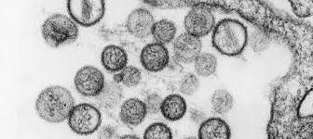




Hantavirus: epidemiology, situation overview, and IPC implications
Jon Otter PhD FRCPath FIBMS
@IPC_Partners
@ipcpartners.bsky.social
@ipcpartners

Slide 2



Insight Webinars: intro
Aims
To provide an expert overview of a relevant topic
To generate discussion
To provide opportunities for CPD
To exercise critical thinking skills
To build confidence for independent research & study
To foster a network of enthusiasts
To have a bit of fun!
https://ipcpartners.org/learn-with-us/
Insight Webinars are recorded and made available online after the event.

Slide 3
Disclaimers
This is my personal view – I am not representing the views of any affiliated organisations
This is a fast-moving situation (what is true today may well be out of date tomorrow)
I am an IPC generalist and not a specific hantavirus expert
This presentation takes a UK-centric view – principles will be applicable elsewhere

Slide 4
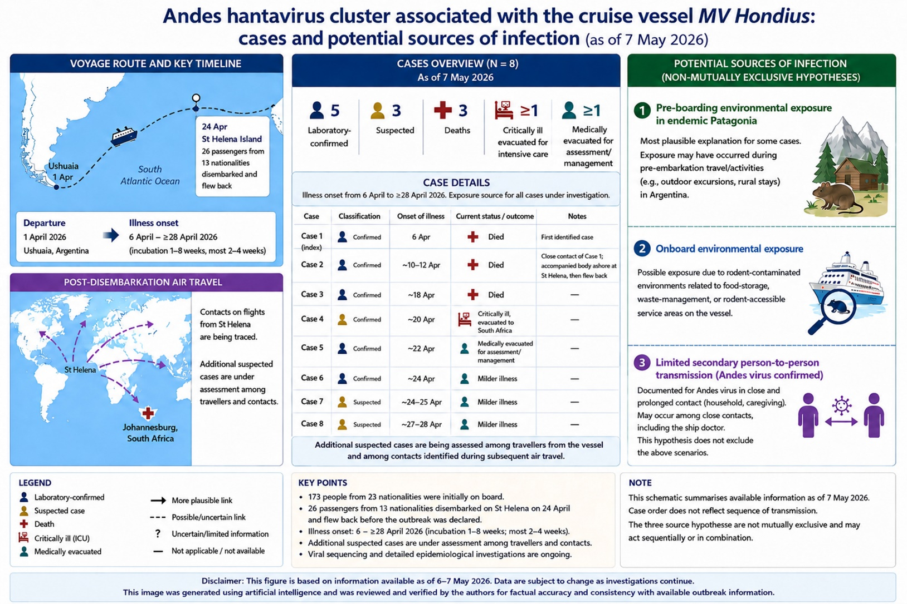
Mora-Rillo et al. Clin Microbiol Infect 2026

Slide 5
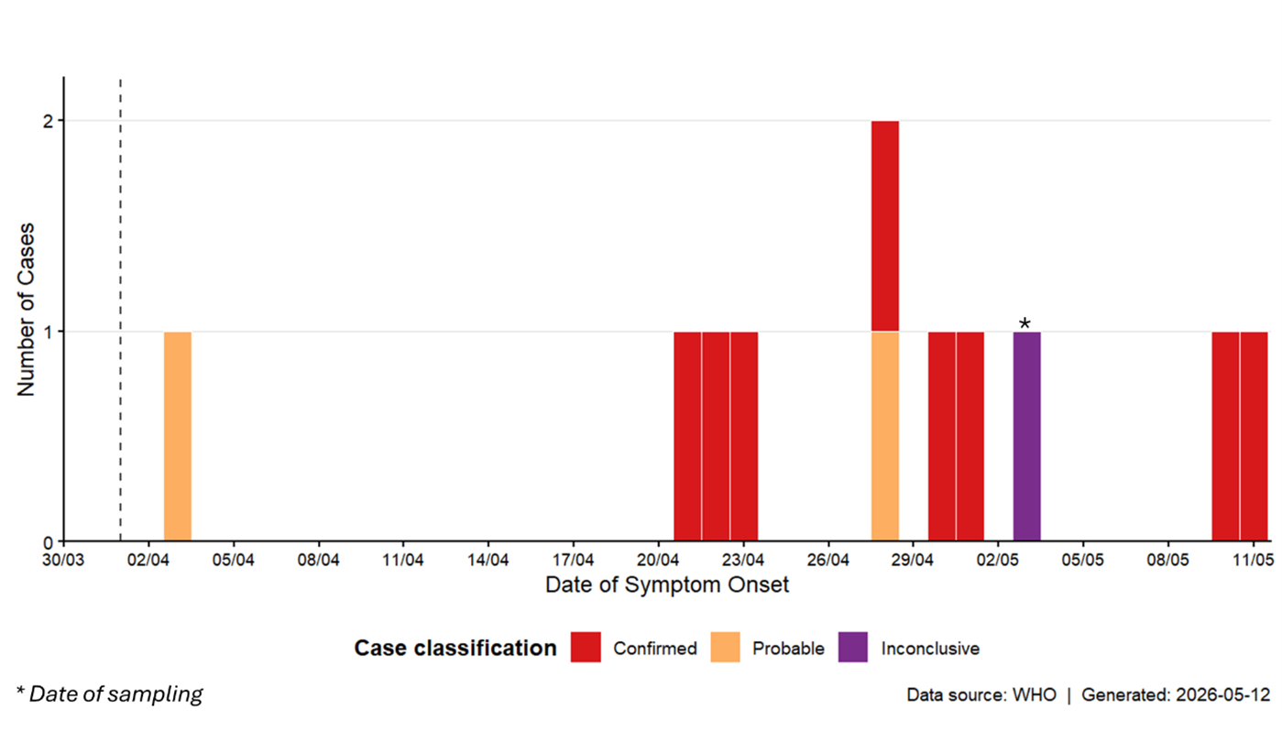
Epidemiological curve of Andes hantavirus cases (n = 11) reported to WHO as of 13 May 2026, 17:00.
WHO, 1130 15/05/2026

Slide 6
Background on Hantavirus
Hantaviruses are from the Bunyaviridae family
Enveloped RNA virus with segmented genome
Transmitted primarily from rodent reservoirs
Two main clinical syndromes:
  Haemorrhagic fever with renal syndrome (HFRS) – Europe/Asia
  Hantavirus cardiopulmonary syndrome (HCPS) – Americas
Key reservoirs:
  Deer mice (Sin Nombre virus)
  Bank voles (Puumala virus)
  Long-tailed pygmy rice rat (Andes virus)
Jonsson et al. Clin Microbiol Rev 2010

Slide 7
Global epidemiology
Global distribution linked to rodent ecology
Incidence driven by:
  Climate variation
  Rodent population dynamics
  Human exposure to rural environments
Regional patterns:
  Europe: Puumala virus (milder HFRS)
  Asia: Hantaan/Dobrava (more severe HFRS)
  Americas: HCPS (higher mortality)
  UK: Seoul hantavirus
Vaheri et al. Lancet Infect Dis 2013

Slide 8
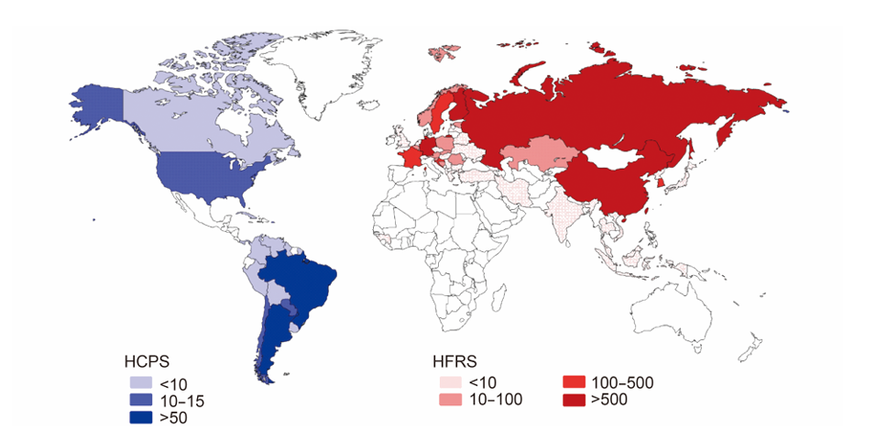
Global epidemiology
Jiang et al. Virologica Sinica 2017.

Slide 9
Clinical features
Phases:
  Febrile phase (non-specific febrile illness with fever, chills and myalgia, and sometimes gastrointestinal symptoms, 3-5 days).
  Cardiopulmonary (HCPS) OR renal (HFRS)
  Shock (severe cases)
Severe disease:
  Respiratory failure, acute respiratory distress syndrome (ARDS), acute pulmonary oedema, shock, coagulopathy and haemorrhage, and cardiac arrhythmias; neurological involvement rare but reported
Mortality:
  HFRS: ~1–15%
  HCPS: up to 30–40%
Afzal et al. Frontiers Microbiol 2023.

Slide 10
Andes virus (ANDV) vs. other hantaviruses
Feature | Andes virus | Other hantaviruses
Geography | South America | Global
Syndrome | HCPS | HFRS or HCPS
Person-to-person transmission | Yes (limited evidence) | No
Case fatality | Up to ~35% | Variable
Reservoir | Rodents | Rodents
IPC concern | Higher | Lower
Martinez-Valdebenito et al. N Engl J Med 2020

Slide 11
Incubation period
Typically: 4-40 days
Median incubation: 18 days following exposure
Variability reflects:
  Viral strain
  Exposure dose
  Host factors
Limited epidemiological data!
Implication: Long monitoring period required for contacts
Vial et al. Emerg Infect Dis 2006; NHS 2026.

Slide 12
Period of infectiousness
For most hantaviruses:
  No human-to-human transmission = not infectious
Andes virus:
  Transmission reported during prodromal/early symptomatic phase
  Pre-symptomatic transmission not reported (but possible)
  Duration of infectiveness unknown
Limited evidence base from outbreaks
Implication: Early isolation recommended for suspected cases with early non-specific symptoms
Martinez-Valdebenito et al. N Engl J Med 2020

Slide 13
Routes of transmission
Primary route (zoonosis):
  Aerosolised rodent excreta (urine, faeces, saliva)
Other possible routes:
  Direct contact with rodents
  Contaminated surfaces
Andes virus:
  Prolonged close-contact transmission reported
  Likely via respiratory secretions
Martinez-Valdebenito et al. N Engl J Med 2020

Slide 14
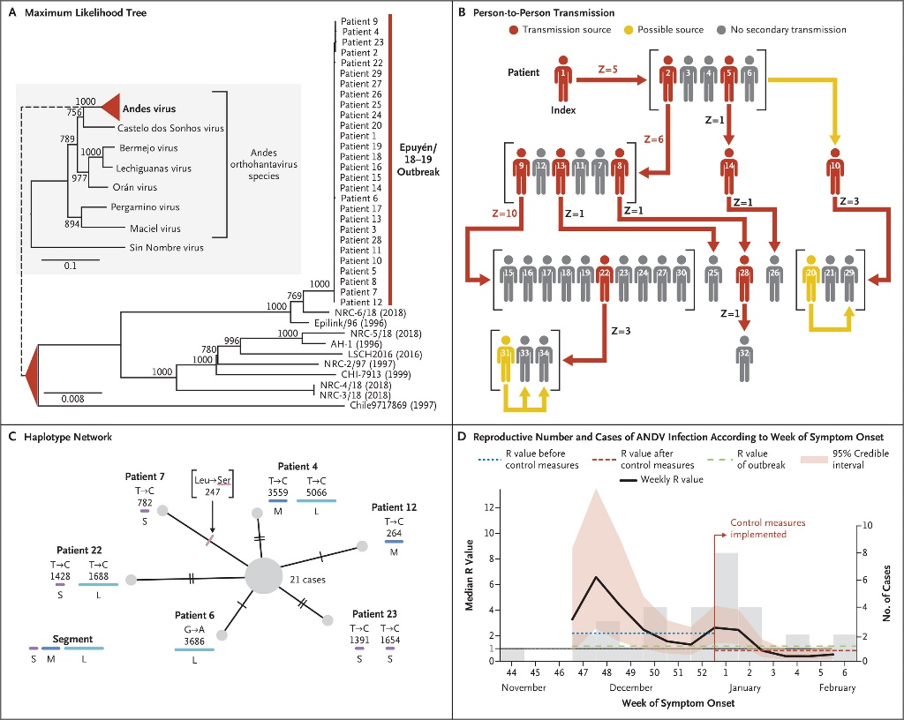
Evidence for human-to-human spread
2018–2019 outbreak in Argentina: 34 cases, 11 deaths following a single zoonotic spillover
Sustained person-to-person transmission (4 generations) – unusual for hantaviruses
Transmission driven by 3 “super-spreaders” at crowded social events
Higher transmission risk linked to high viral load and liver injury, not viral mutation
Reproductive number (R) reduced from ~2.1 to <1 after isolation and quarantine measures
Findings highlight importance of close contact, social context, and early control measures in ANDV spread
Martinez-Valdebenito et al. N Engl J Med 2020

Slide 15
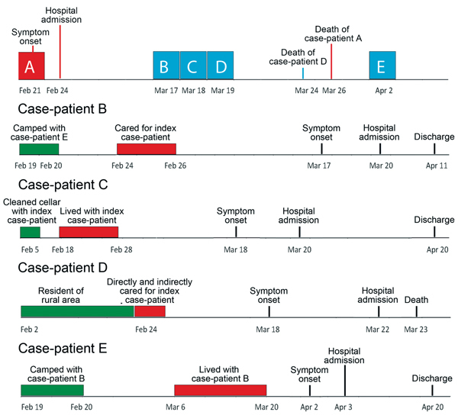
Evidence for human-to-human spread
Andes hantavirus transmission (Chile, 2011)
Cluster of 5 cases identified; 1 index case (rodent exposure) and 4 secondary cases
Strong epidemiological + genomic evidence of person-to-person transmission
Secondary cases included 2 household contacts and 2 healthcare workers (nosocomial transmission).
Transmission linked to close contact during febrile prodrome (e.g. caregiving, handling bedding, kissing)
Martinez-Valdebenito et al. Emerg Infect Dis 2014

Slide 16
Comparing transmissibility
Pathogen | R₀
Measles | 12–18
VZV | 8–10
SARS-CoV-2 | 2–8+
Pandemic influenza | ~2.5
Andes hantavirus | ~2
Seasonal influenza | 1–2
Other hantaviruses | ~0 (non-transmissible)

Slide 17
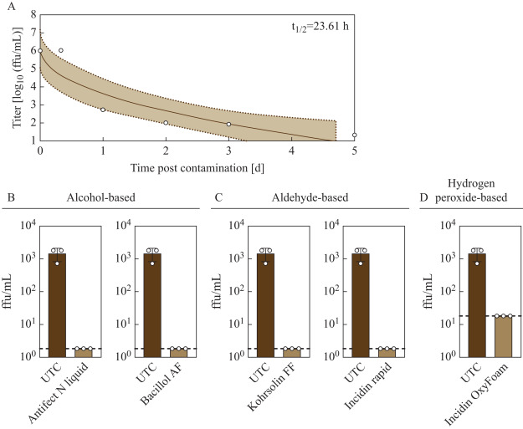
Surface survival and inactivation
ANDV shows limited environmental stability, but can remain viable on stainless steel for up to 5 days (half-life ~24h).
Alcohol-based hand rubs rapidly inactivate ANDV within 30 seconds, even at reduced concentrations.
All tested surface disinfectants (alcohol-, aldehyde-, and hydrogen peroxide–based) achieved complete inactivation.
ANDV is more susceptible than some other enveloped viruses, supporting standard disinfection approaches.
Nilsson-Payant et al. J Hosp Infect 2025

Slide 18
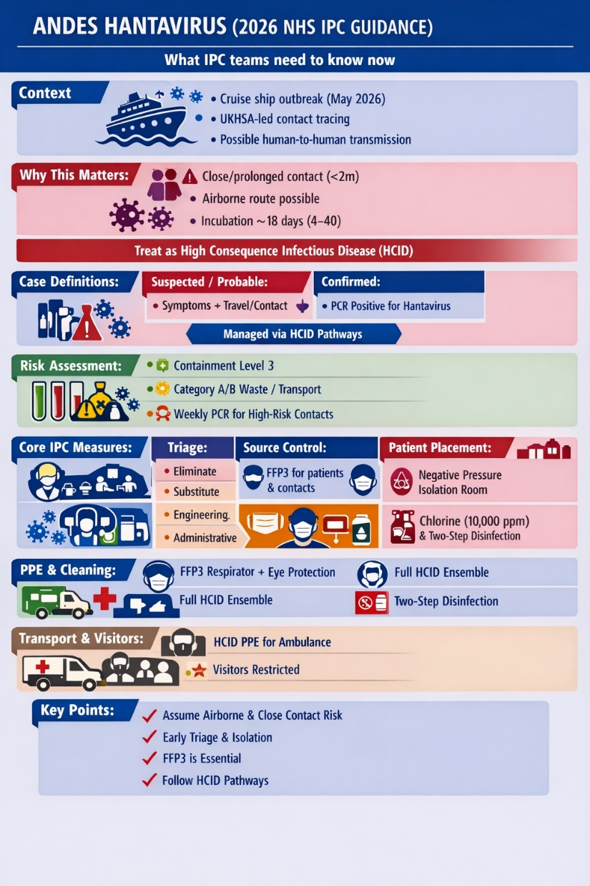
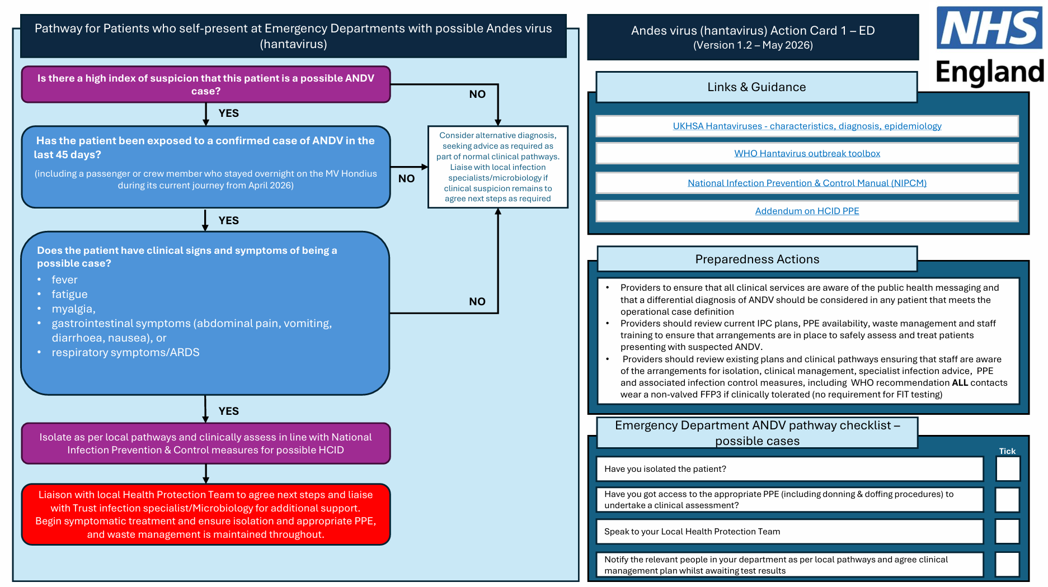
Main guidance
Accompanying action cards
  ED
  Inpatient
  Outpatient
  Contact
NHS 2026; AI gen summary graphic (left).

Slide 19
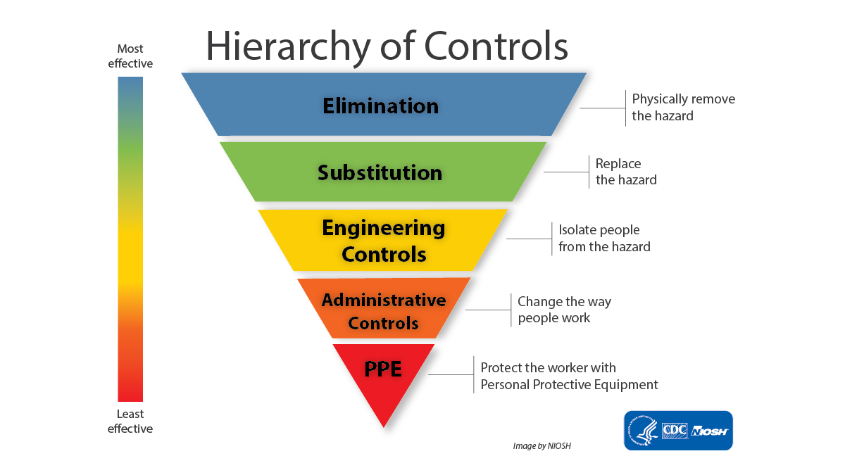

Slide 20
Case definitions
Case type | Clinical criteria | Epidemiological link | Lab criteria
Possible | Compatible symptoms (fever, fatigue, myalgia, GI ± respiratory/ARDS) | Contact with someone who travelled on MV Hondius (from 1 April 2026) within 45 days | No alternative pathogen identified
Probable | Compatible symptoms (as above) | Either travelled on MV Hondius or contact with confirmed/probable case (within 45 days) | No alternative pathogen identified
Confirmed | Not required (derived) | Either travelled on MV Hondius or contact with passenger (within 45 days), or UKOT exposure | PCR positive for hantavirus
Asymptomatic contact
Surveillance samples required
Diagnostics
Directed by UKHSA Imported Fever Service
Samples sent to Rare and Important Pathogens Lab (RIPL)
Mostly Category B for sample transport (unless confirmed positive)
Contact = close contact i.e. within 2 metres
NHS 2026

Slide 21
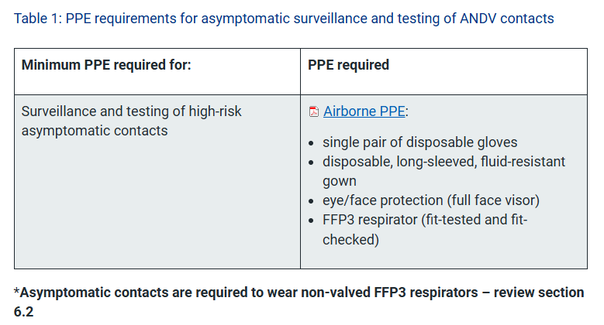
PPE – asymptomatic contact
NHS 2026

Slide 22
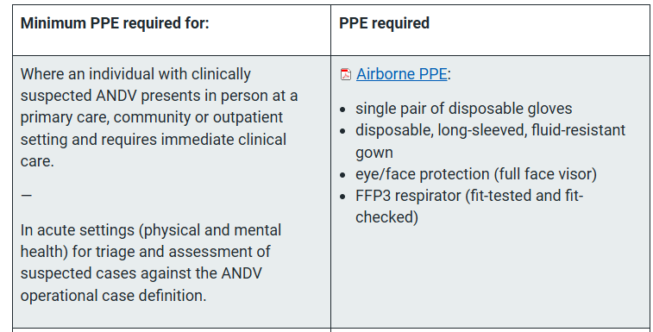
PPE – suspected or confirmed case
NHS 2026

Slide 23
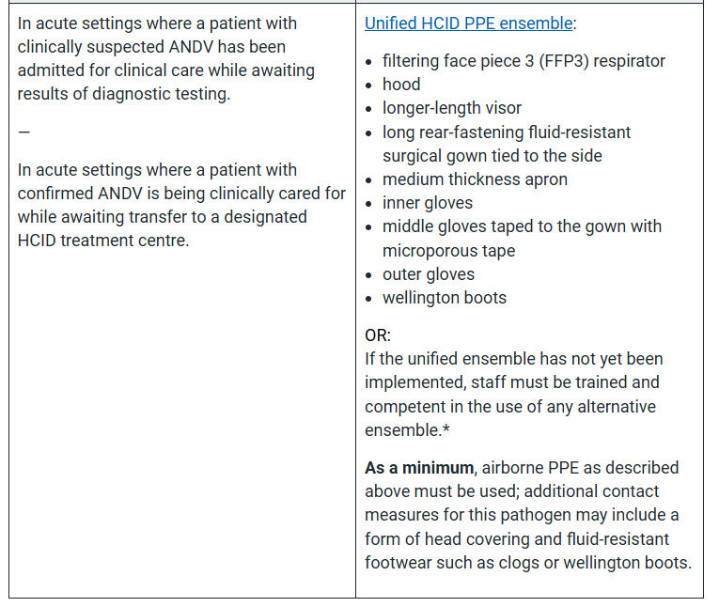
PPE – suspected or confirmed case
NHS 2026

Slide 24
Environmental cleaning & disinfection
ANDV is susceptible to a range of disinfectants commonly used in healthcare settings
2x rounds of cleaning and disinfection required for suspected or confirmed cases in any care setting
10,000 ppm available chlorine solution recommended as first line, 70% alcohol as second
  For reusable medical equipment, either 10,000 ppm available chlorine or 70% alcohol
‘Fumigation’ recommended for confirmed cases in non-HCID units
NHS 2026

Slide 25
Key actions
Get your clinical pathways sorted
Early symptom recognition and travel history
Be familiar with the current case definitions
PPE
  Be prepared to use FFP3 for patient contacts and suspected / confirmed cases
  Staff briefed on local PPE decisions
Environmental cleaning & disinfection – local plan required

Slide 26
Research priorities
Epidemiology
  Person-to-person transmission dynamics
  Period of infectiousness
  Infectivity
  Prevalence of low-grade / asymptomatic infection
Impact of treatment (e.g. antivirals, immunotherapy)
Vaccine development
Effectiveness of IPC interventions

Slide 27
Hantavirus: epidemiology, situation overview, and IPC implications
Jon Otter PhD FRCPath FIBMS
@IPC_Partners
@ipcpartners.bsky.social
@ipcpartners

Slide 28



​
Next up: Journal Club
"How everyday actions and everyday language shape infection prevention and antimicrobial resistance outcomes"
(Jules Storr & Dr Claire Kilpatrick, 20th May 2026)

Slide 29

Subscribe to hear about future IPC Partners Journal Clubs, Insight Webinars, and other updates

Slide 30




HIS
Webinars
FIS Webinar Series
Infection Specialist Workforce Report
3 June 12:00 - 13:00

Slide 31
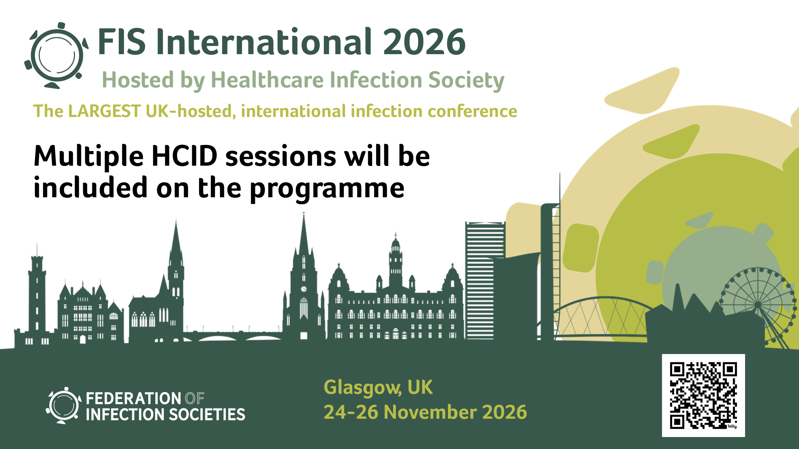

Slide 32


