Slide 1



Top 10 papers:
Priority Pathogens / AMS
AI / Technical Innovations
Dr Phil Norville: Research Fellow, CEO and Co-founder IPC Partners
Dr Jon Otter: Director of Infection Prevention and Control, Consultant Clinical Scientist, Honorary Senior Lecturer, Co-founder IPC Partners
Mentimeter…

Slide 2
Artificial Intelligence / Technical
Innovations

Slide 3
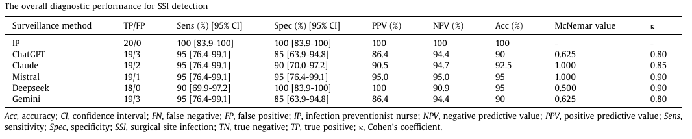
AI/Technical Innovations
Abbas et al., Am J Infect Control 2026;54:451-453. Leveraging artificial intelligence for surgical site infection surveillance: A comparison of 5 large language models.
1
Why I chose this paper: Explores whether readily available LLMs can automate one of the most time-consuming IPC activities: SSI surveillance.
Study design: Retrospective single-centre pilot study comparing five LLMs with manual NHSN-based SSI surveillance in 40 abdominal surgery patients (20 SSI, 20 non-SSI).
Key findings: All LLMs achieved high diagnostic accuracy (90-95%) with strong agreement to manual review (κ 0.80-0.90) and no significant difference from the infection preventionist.
Limitations: Small sample size, single-centre retrospective design, and findings may be influenced by documentation quality and use of a single standardised prompt.
Significance for IPC: Suggests AI could substantially reduce surveillance workload and augment infection prevention teams, although prospective validation is still needed before routine implementation.

Slide 4
AI/Technical Innovations
Price et al., From potential to practice: a UK national roadmap to implement pathogen whole-genome sequencing in infection prevention and control. Lancet Microbe. 2026 Jul 31:101491.
Why I choose this paper: Sets out a national implementation roadmap to use genomic (WGS) information in a clinically useful and cost-effective way. Implications for other interventions in IPC?
Key findings
- Prioritise high-risk pathogens, outbreaks and settings
- Deliver actionable results within 24–72 hours
- Link regional sequencing with local IPC and national surveillance
- Standardise analysis, interpretation and reporting
- Integrate genomic, clinical and epidemiological data
- Evaluate impact and cost-effectiveness before wider adoption
2

Slide 5
AI/Technical Innovations
Price et al., From potential to practice: a UK national roadmap to implement pathogen whole-genome sequencing in infection prevention and control. Lancet Microbe. 2026 Jul 31:101491.
2
Challenge | Simplified solution
Fragmented leadership | National coordination, standards and commissioning
Disconnected data systems | Interoperable regional and national infrastructure
Unclear economic value | Real-world cost-effectiveness evaluation
Inconsistent interpretation | Standardised analysis and reporting frameworks
Workforce limitations | Accredited multidisciplinary training and expertise
Unequal access | National minimum standards and targeted investment
Governance and public trust | Clear governance, transparency and public engagement
Research–practice gap | Embed implementation science into service development

Slide 6
AI/Technical Innovations
Price et al., From potential to practice: a UK national roadmap to implement pathogen whole-genome sequencing in infection prevention and control. Lancet Microbe. 2026 Jul 31:101491.
Limitations: Personal view/piece
Significance for IPC: The future challenge is integrating genomic data into routine IPC decision-making.
2

Slide 7
AI/Technical Innovations
Tanner et al., BMJ Open 2026 Jul 31;16(7):e116323. Exploring patient and NHS staff acceptability of artificial intelligence-supported surgical wound monitoring within the WISDOM feasibility study: a multi-centre qualitative interview study
3
“I’m super- excited about the fact that you’re using AI
to do this.”
“There’s some people who are not tech savvy that may (struggle) but those people will always have someone around you.”
“It felt a little unusual in the beginning, putting your trust in something that isn't physical, it’s not a per son, it’s not a colleague.”
“I think it will make the workload of the staff a lot easier.”
Why I chose this paper: Moves beyond AI accuracy to address the critical question of whether patients and staff will actually accept and adopt AI-enabled wound surveillance.
Study design: Multi-centre qualitative interview study involving 20 cardiac surgery patients and 10 NHS staff participating in the WISDOM AI wound-monitoring feasibility trial.
Key findings: Patients and staff were overwhelmingly supportive, citing earlier SSI detection, improved access, reassurance, efficiency and scalability, while highlighting concerns about data security, over-reliance on AI and loss of human contact.
Limitations: Small feasibility study in two cardiac centres with potential selection bias and uncertain generalisability to routine large-scale implementation.
Significance for IPC: Demonstrates that AI-supported post-discharge wound surveillance appears acceptable to end-users and could support earlier SSI recognition and wider surveillance coverage at scale.

Slide 8
AI/Technical Innovations
Waggle et al., Methods for cost-efficient, whole-genome sequencing surveillance for enhanced detection of outbreaks in a hospital setting. medRxiv.
Why I chose this paper: Provides a practical, real-world model for implementing routine WGS surveillance. Directly addresses important barriers including cost, laboratory capacity, technical expertise and operational workflow.
Key findings:
- 7,813 bacterial isolates sequenced over three years
- Weekly throughput increased from 60 to 80 samples
- Cost reduced from under $100 to under $70 per sample
- Average end-to-end turnaround time was 10 days
- Results were reviewed with EHR data and reported to IPC teams for targeted action
4

Slide 9
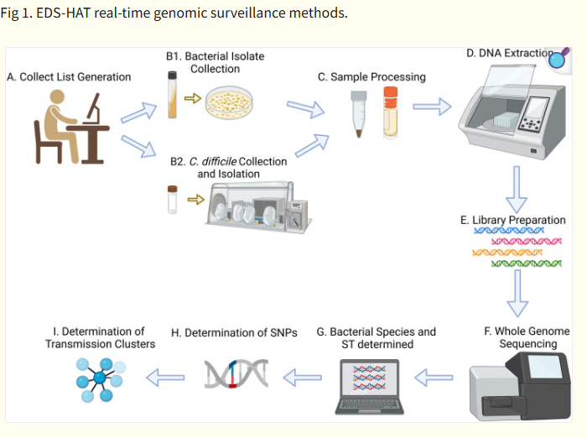
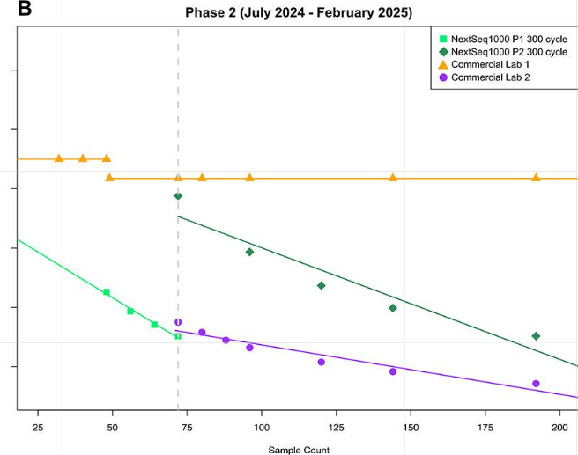
AI/Technical Innovations
Waggle et al., Methods for cost-efficient, whole-genome sequencing surveillance for enhanced detection of outbreaks in a hospital setting. medRxiv.
4

Slide 10
AI/Technical Innovations
Waggle et al., Methods for cost-efficient, whole-genome sequencing surveillance for enhanced detection of outbreaks in a hospital setting. medRxiv.
Limitations: Single-system implementation study and preprint that has not undergone journal peer review. Costs excluded major equipment and infrastructure.
Significance for IPC: Routine genomic surveillance can be delivered at scale and decreasing cost. However, its value depends on integrating sequencing results with patient epidemiology and delivering findings quickly enough to influence IPC actions/decisions.
4

Slide 11
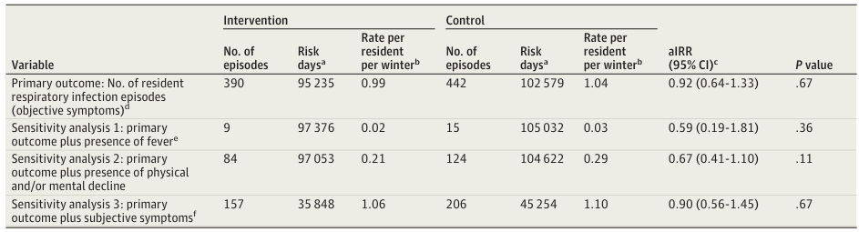
AI/Technical Innovations
Hay et al., JAMA Intern Med 2026;186;(9):1124-1134. High-Efficiency Particulate Air Filters to Prevent Winter Respiratory Infections in Care Homes. The AFRI-c Cluster Randomized Clinical Trial.
Why I chose this paper: A large, definitive RCT addressing a major IPC question: can air cleaning technology reduce respiratory infections in high-risk care home populations?
Study design: Pragmatic cluster-randomised trial in 91 English care homes comparing HEPA filtration in communal areas and bedrooms versus usual IPC measures over one winter season.
Key findings: HEPA filters did not reduce respiratory infection rates, antibiotic use, outbreaks, or staff absenteeism compared with standard care.
Limitations: Conducted during and immediately after the COVID-19 pandemic when enhanced IPC measures may have reduced transmission and limited any additional HEPA benefit.
Significance for IPC: High-quality evidence that resources may be better directed towards other IPC measures such as vaccination, ventilation, hand hygiene and cleaning.
5

Slide 12
Mentimeter…

Slide 13
Priority Pathogens / AMS

Slide 14
Priority pathogens/AMS
Okeke et al., Understanding the epidemiology of Candidozyma auris: a case–control study at an acute hospital in London, UK. J Hosp Infect. 2026 Jun;172:97-101
Why I choose this paper: C. auris is a challenging organism for IPC (environmental, colonisation, AMR). Epidemiology information supports IPC decision making/policy etc.
Key findings:
- No increase in length of hospital stay
- 76 cases matched with 152 controls
- Antibacterial exposure strongly associated with colonisation: OR 8.4
- Doppler probe exposure independently associated with colonisation: OR 3.8
- Longer pre-testing hospital exposure increased risk: OR 1.02 per day
- No association with mortality or indwelling devices
6

Slide 15
Priority Pathogens/AMS
Okeke et al., Understanding the epidemiology of Candidozyma auris: a case–control study at an acute hospital in London, UK. J Hosp Infect. 2026 Jun;172:97-101
Limitations: Study undertaken during an outbreak, not representative.
Significance for IPC: Environmental decontamination is vital in the control (particularly shared medical equipment). Doppler probes and other shared devices validated decontamination processes and compliance monitoring. Early screening may also identify colonised patients before further transmission occurs.
6

Slide 16
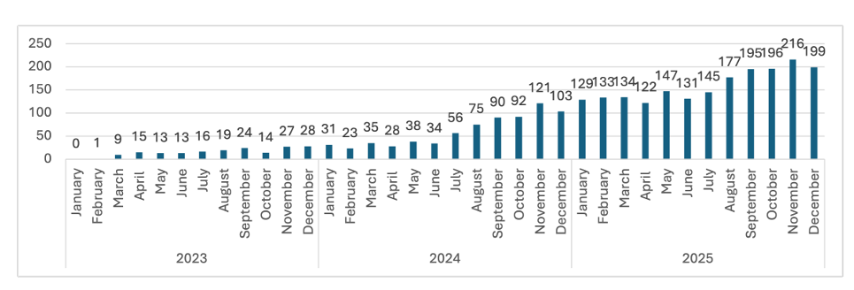
Priority Pathogens / AMS
Bali et al., J Hosp Infect 2026 in press. Epidemiology and Outcomes of Candida auris Infections in Türkiye: A National Surveillance Study, 2023–2025.
Why I chose this paper: Provides one of the largest national datasets on C. auris to date and illustrates how quickly this pathogen can emerge as a major IPC threat.
Study design: National surveillance study of all laboratory-confirmed C. auris infections reported to Türkiye’s mandatory healthcare-associated infection surveillance system from February 2023 to December 2025.
Key findings: 2,829 infections were reported, incidence increased more than tenfold over three years (0.5 to 5.5 per 100,000 patient days), 96.6% were bloodstream infections, 76.4% were CLABSIs, and in-hospital mortality was 49.8%.
Limitations: Captured infections but not colonisation, lacked antifungal susceptibility data, had 33.1% missing outcome data, and may underestimate burden in smaller hospitals.
Significance for IPC: Reinforces C. auris as a rapidly emerging healthcare pathogen requiring robust surveillance, screening, device stewardship, environmental decontamination, and rapid IPC response.
7

Slide 17
Priority Pathogens/AMS
Meda et al., Polymicrobial outbreak of carbapenemase-producing Enterobacterales managed using universal admission and discharge screening and water-safe built environment. J Hosp Infect. 2025;156:1-12.
Why I chose this paper: Management of CPE utilising water-safe and built environment
Key findings:
- 65 CPE positive cases, 73%, were likely healthcare acquired
- Predominantly NDM and OXA-48 producers
- Hospital wastewater acted as the outbreak reservoir
- Water-safe interventions and universal screening produced a sustained reduction in transmission
8

Slide 18
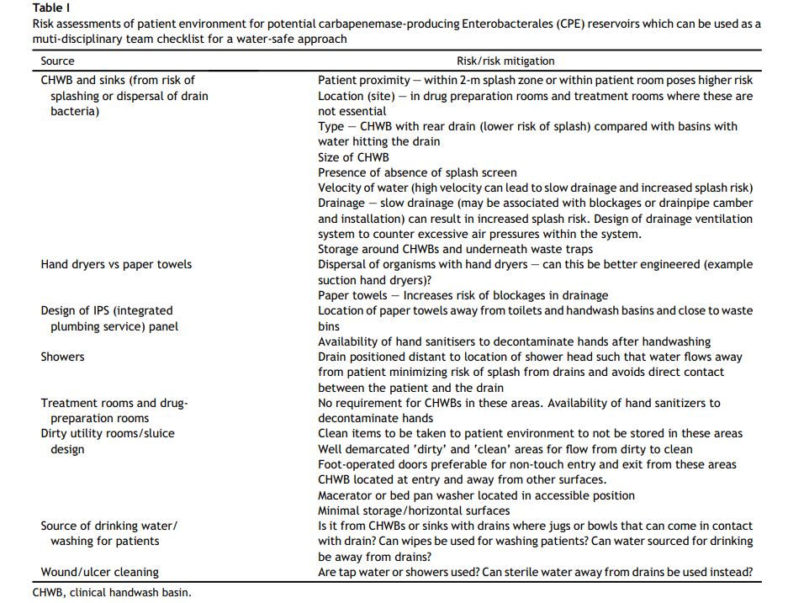
Priority Pathogens/AMS
Meda et al., Polymicrobial outbreak of carbapenemase-producing Enterobacterales managed using universal admission and discharge screening and water-safe built environment. J Hosp Infect. 2025;156:1-12.
8

Slide 19
Priority Pathogens/AMS
Meda et al., Polymicrobial outbreak of carbapenemase-producing Enterobacterales managed using universal admission and discharge screening and water-safe built environment. J Hosp Infect. 2025;156:1-12.
Limitations: Single-centre outbreak investigation; the individual contribution of screening and wastewater interventions cannot be separated.
Significance for IPC: Water-safe care shows continued promise in dealing with outbreaks. Role in the New Hospitals Programme/new builds?
8

Slide 20
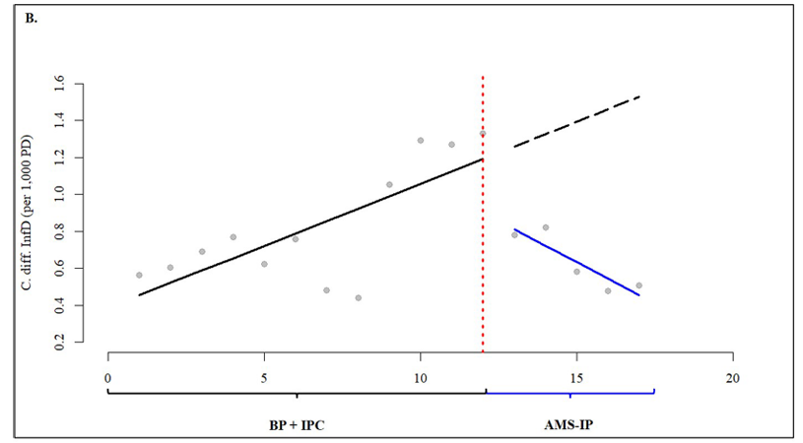
Priority Pathogens / AMS
Classen et al., Clin Microbiol Infect 2025;31:2025-2032. Impact of enhanced infection control and antimicrobial stewardship on infections by Clostridioides difficile, vancomycin-resistant enterococci, and third-generation cephalosporin-resistant Enterobacterales: a stepped-wedge cluster intervention study.
9
Why I chose this paper: One of the few high-quality multicentre studies demonstrating that antimicrobial stewardship can directly reduce healthcare-associated infections, not just antibiotic consumption.
Study design: Multicentre stepped-wedge cluster intervention study across 15 departments in five German university hospitals evaluating enhanced IPC followed by enhanced AMS.
Key findings: Combined IPC and AMS interventions significantly reduced Clostridioides difficile infection incidence, but did not significantly reduce VRE or 3GCRE bloodstream infections.
Limitations: Conducted in hospitals with mature IPC and AMS programmes, low baseline infection rates, relatively short follow-up, and limited power to detect changes in rare bloodstream infections.
Significance for IPC: Provides strong evidence that AMS is an IPC intervention, with measurable impact on CDI prevention and an important role alongside traditional infection control measures.
BP = baseline period; IPC = infection prevention and control; AMS-IP = antimicrobial stewardship intervention period.

Slide 21
Priority Pathogens/AMS
Chowdhury et al., Transmission of dry surface biofilm via and through cotton bedsheets: implications for hospital infection control. J Hosp Infect. 2026;175:104-111.
Why I chose this paper: Dry surface biofilm fascinates me! What about transfer from DSB to patients though?
Key findings:
- S. aureus biofilm transferred via and through cotton sheets
- Wetting significantly increased bacterial transfer
- 250-thread sheets transferred less bacteria than 150-thread sheets
- Clinical mattress and pillow covers contained high bacterial loads
10

Slide 22
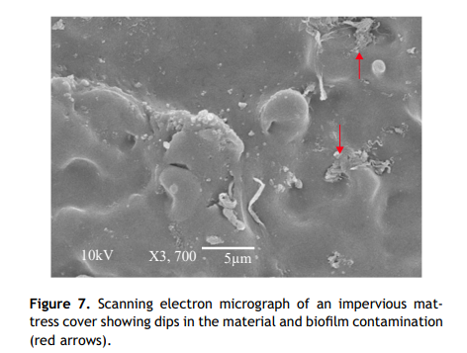
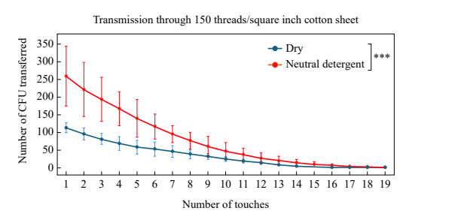
Priority Pathogens/AMS
Chowdhury et al., Transmission of dry surface biofilm via and through cotton bedsheets: implications for hospital infection control. J Hosp Infect. 2026;175:104-111.
10

Slide 23
Priority Pathogens/AMS
Chowdhury et al., Transmission of dry surface biofilm via and through cotton bedsheets: implications for hospital infection control. J Hosp Infect. 2026;175:104-111.
Limitations: Predominantly laboratory-based study using a single S. aureus strain and a simplified detergent-wetting model; clinical samples came from decommissioned mattress covers.
Significance for IPC: Bedsheets and mattresses are reservoirs for DSB and can be transferred multiple times! Highlights the importance of environmental decontamination.
10

Slide 24
Mentimeter…

Slide 25




An introduction to Journal Clubs /
Insight Webinars
Aims
To provide an expert overview of a relevant topic
(Insight Webinars) or paper (Journal Club)
To generate discussion
To provide opportunities for CPD
To exercise critical thinking skills
To build confidence for independent research & study
To foster a network of enthusiasts
To have a bit of fun!
https://ipcpartners.org/learn-with-us/
Insight Webinars and Journal Clubs are recorded and made available online after the event.

Slide 26
Thank you
hello@ipcpartners.org

