Slide 1
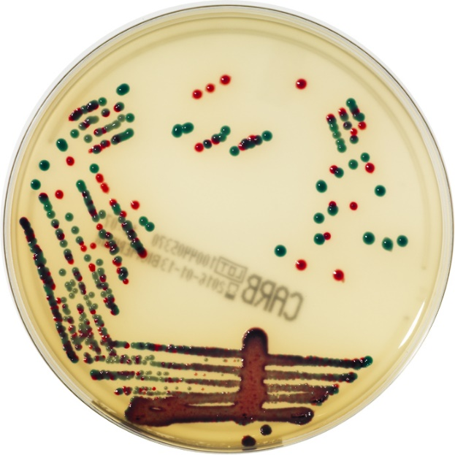





Carbapenem-resistant Enterobacterales in healthcare and community settings
Jon Otter PhD FRCPath,
Director of Infection Prevention and Control & Consultant Clinical Scientist
Guy’s and St Thomas’ NHS Foundation Trust
Honorary Senior Lecture in HCAI & AMR, Imperial College London
@jonotter
@jon-otter.bsky.social
j.otter@imperial.ac.uk

Slide 2
What’s the problem?
How bad is it?
How do we stop it?

Slide 3
What’s the problem?
How bad is it?
How do we stop it?

Slide 4
CPE outbreak @ Imperial (K. pneumoniae NDM)
8 cases first identified by clinical culture, 32 by screening culture; of these 32, 14 had a subsequent positive clinical culture
Otter et al. Sci Rep 2017;7:12711.

Slide 5
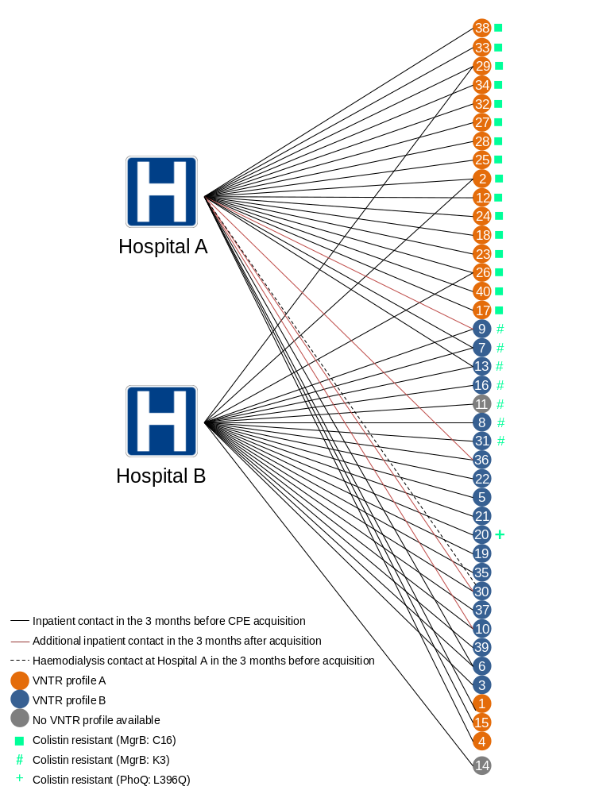
Emergence of colistin resistance
Otter et al. Sci Rep 2017;7:12711.
Notes:
66% of isolates colistin resistant (according to ref lab); 24% of isolates colistin resistant when tested locally.

Slide 6
Contact precautions
The number of inpatients with known CPE carriage, daily
1831 contact precautions days generated, at a cost of £61,575 (£37,389 in gloves and aprons, £23,588 in stock disposal, and £598 in infectious waste disposal)

Slide 7
CPE
Rapid spread
Clinical impact
£
AMR

Slide 8








What’s the problem? ££££
Economic evaluation of a 40 case outbreak of CRE. Error bars represent range
Otter et al. Clin Microbiol Infect 2016.

Slide 9
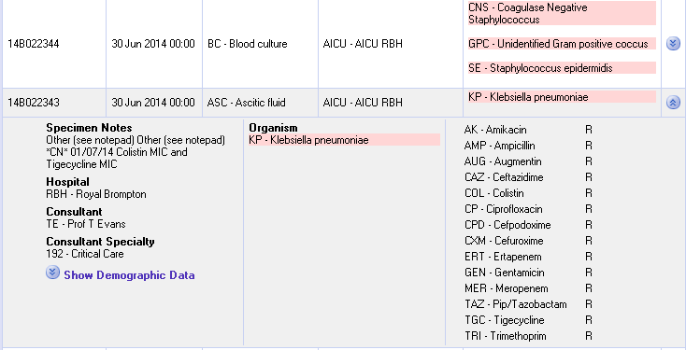
What’s the problem? Resistance

Slide 10
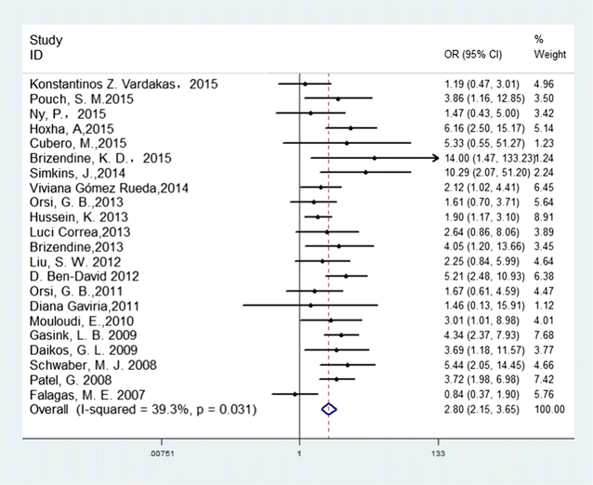
What’s the problem? Mortality
Crude odds ratio (OR) for the association between carbapenem resistance and mortality of patients with K. pneumoniae infection
Xu et al. Annal Clin Microbiol Antimicrob 2017.

Slide 11
Carbapenem-resistant bloodstream infection is really bad news in ICU – and not all CPE are equal
Retrospective observational study from 19 Italian hospitals between 2018 and 2020. A total of 1276 monoclonal Gram-negative BSIs were included (polymicrobial BSIs were excluded). 30% (!) of these ICU-associated BSIs were CPE.
Carbapenam-resistant Gram negative bacilli | Crude 30-Day Mortality | Adjusted Odds Ratio of Death | Attributable Mortality, Controls: Patients With Carbapenem-Susceptible Bloodstream Infection
KPC–producing Enterobacterales | 26.5% | 1.43 (0.92–2.22) | 5%
MBL*–producing Enterobacterales | 36.4% | 5.86 (2.72–12.76) | 35%
CR Pseudomonas aeruginosa | 32.8% | 2.99 (1.48–5.95) | 19%
CR Acinetobacter baumannii | 43.2% | 2.65 (1.52–4.61) | 16%
MBLs* include NDM, VIM, and IMP carbapenemases
Falcone et al. Clin Infect Dis 2023.

Slide 12
What’s the problem? Rapid spread
Rapid spread
Clonal expansion
GI carriage
Horizontal gene transfer

Slide 13
Acronym minefield
CPC
CPE
MDR-GNR
CRO
MDR-GNB
ESBL
CRE
CRC
CPE
KPC
CRAB

Slide 14
Rising threat from multidrug-resistant Gram-negative bacteria
% of all HAI caused by GNRs.
% of ICU HAI caused by GNRs.
Non-fermenters | Acinetobacter baumannii Pseudomonas aeruginosa Stenotrophomonas maltophilia
Enterbacterales | Klebsiella pneumoniae Escherichia coli Enterobacter cloacae
CPO
CPE
Hidron et al. Infect Control Hosp Epidemiol 2008;29:966-1011.
Peleg & Hooper. N Engl J Med 2010;362:1804-1813.

Slide 15
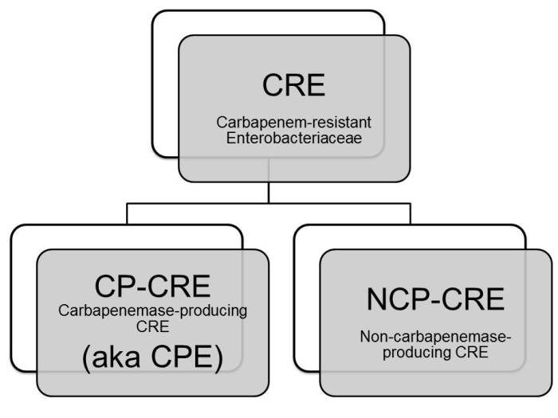

Slide 16
The emerging threat of CPE
Pathogen | CPE | MRSA | VRE | C. difficile
Resistance | +++ | + | + | +/-
Resistance genes | Multiple | Single | Single | n/a
Species | Multiple | Single | Single | Single
HA vs CA | HA & CA | HA | HA | HA
At-risk pts | All | Unwell | Unwell | Old
Virulence | +++ | ++ | +/- | +
Environment | +/- | + | ++ | +++

Slide 17
What’s the problem?
How bad is it?
How do we stop it?

Slide 18
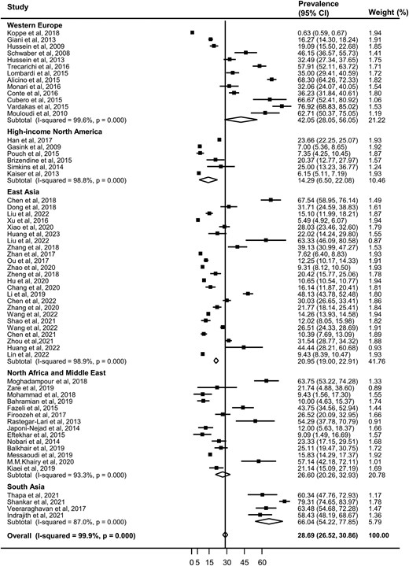
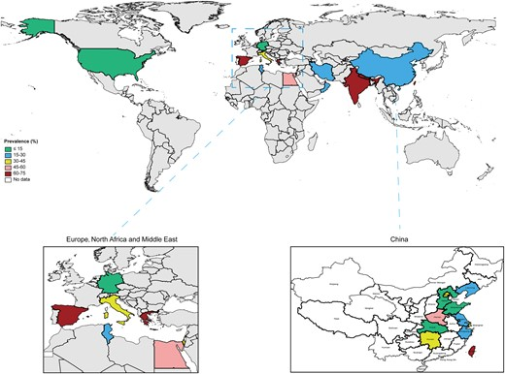
Global prevalence of CR amongst healthcare-associated K. pneumoniae
Lin et al. Open Forum Infec Dis 2024.

Slide 19
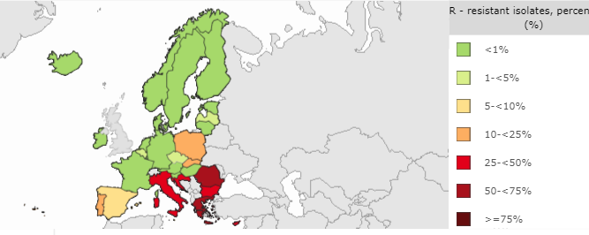
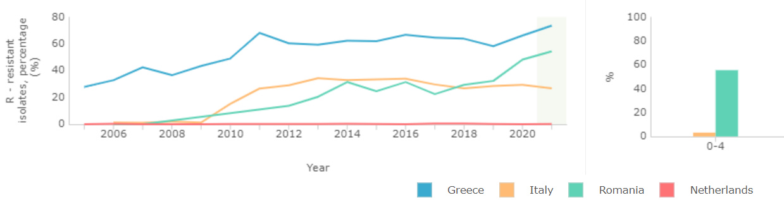
CRE around Europe
% invasive K. pneumoniae isolates resistant to carbapenems (CRE)
ECDC 2023.

Slide 20
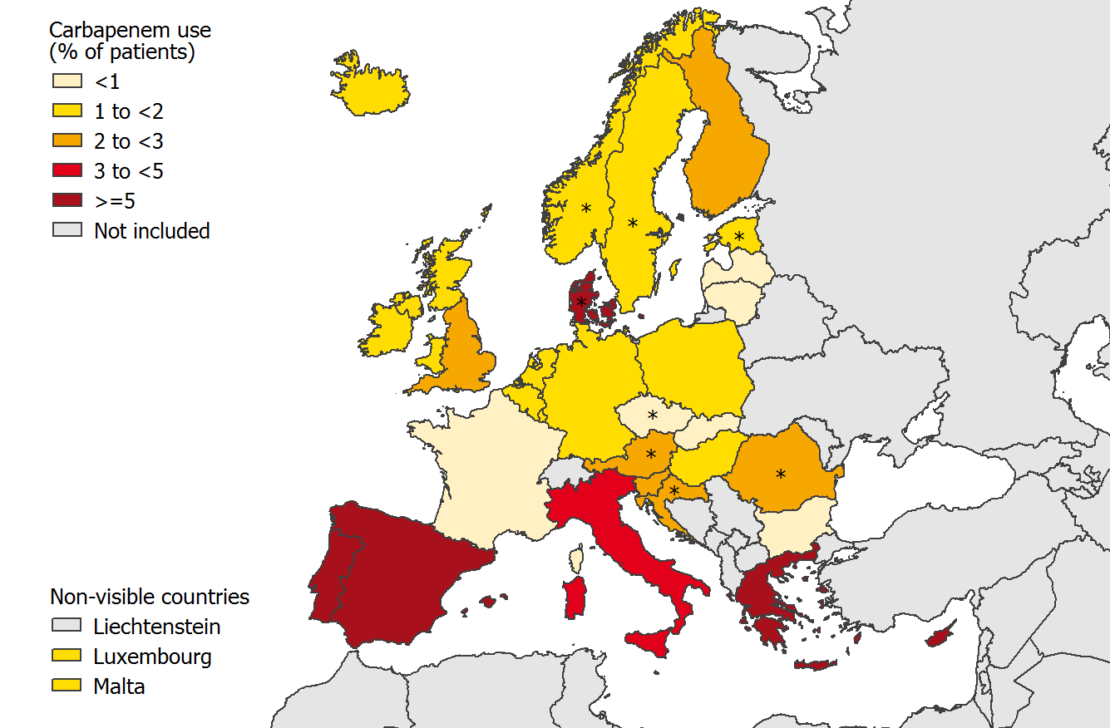
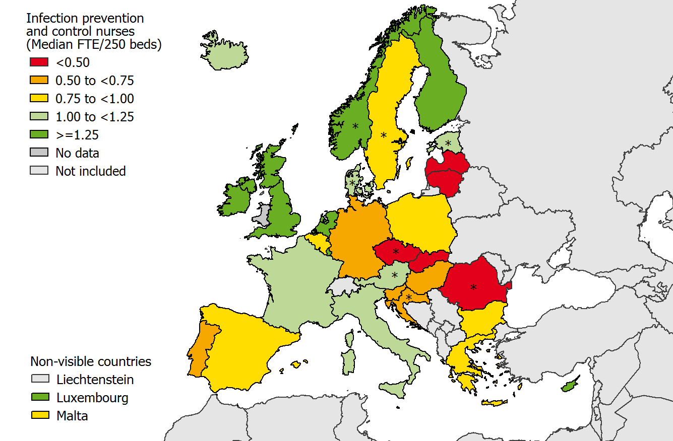
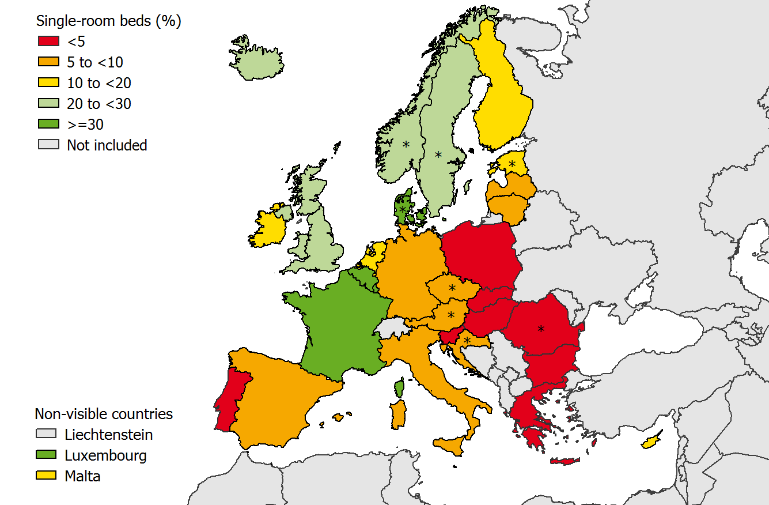
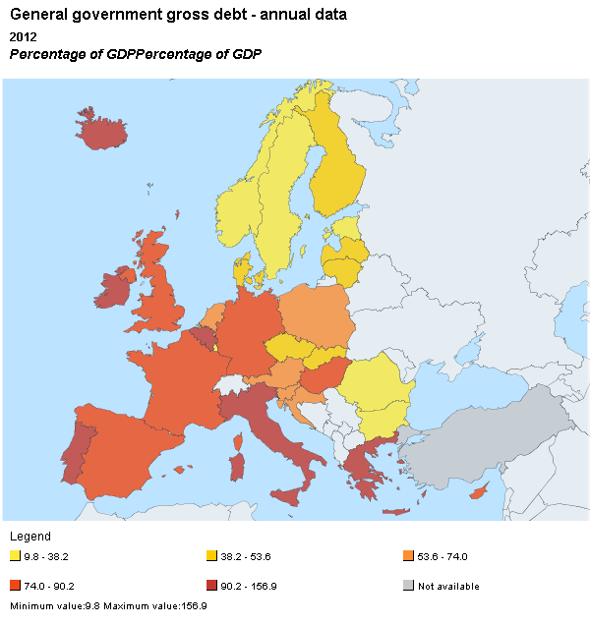
What drives the European ‘north-south divide’?
Antibiotic use
Infection control staffing
Single room availability
National debt
1. ECDC Point Prevalence Survey, 2013.
2, National debt as a percentage of GDP. "Eurostat public debt GDP" by Eurostat. Licensed under Attribution via Wikimedia Commons.

Slide 21
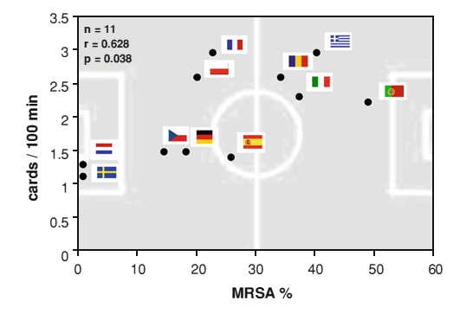
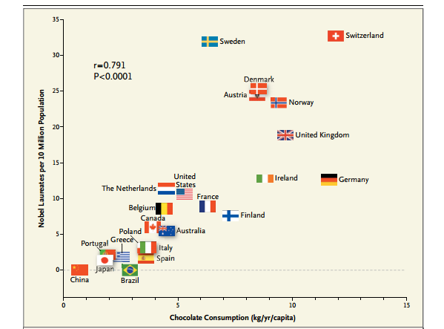
What drives the European ‘north-south divide’?
Correlation between MRSA rate in BSIs and an indicator for fair play from the European Football Championships (red or yellow cards / 100 min)¹
Correlation between national chocolate consumption and rate of Nobel prize winners.²
Meyer et al. Infection 2012 in press.
Messerli FH. New Engl J Med 2012;367:1562-4.

Slide 22
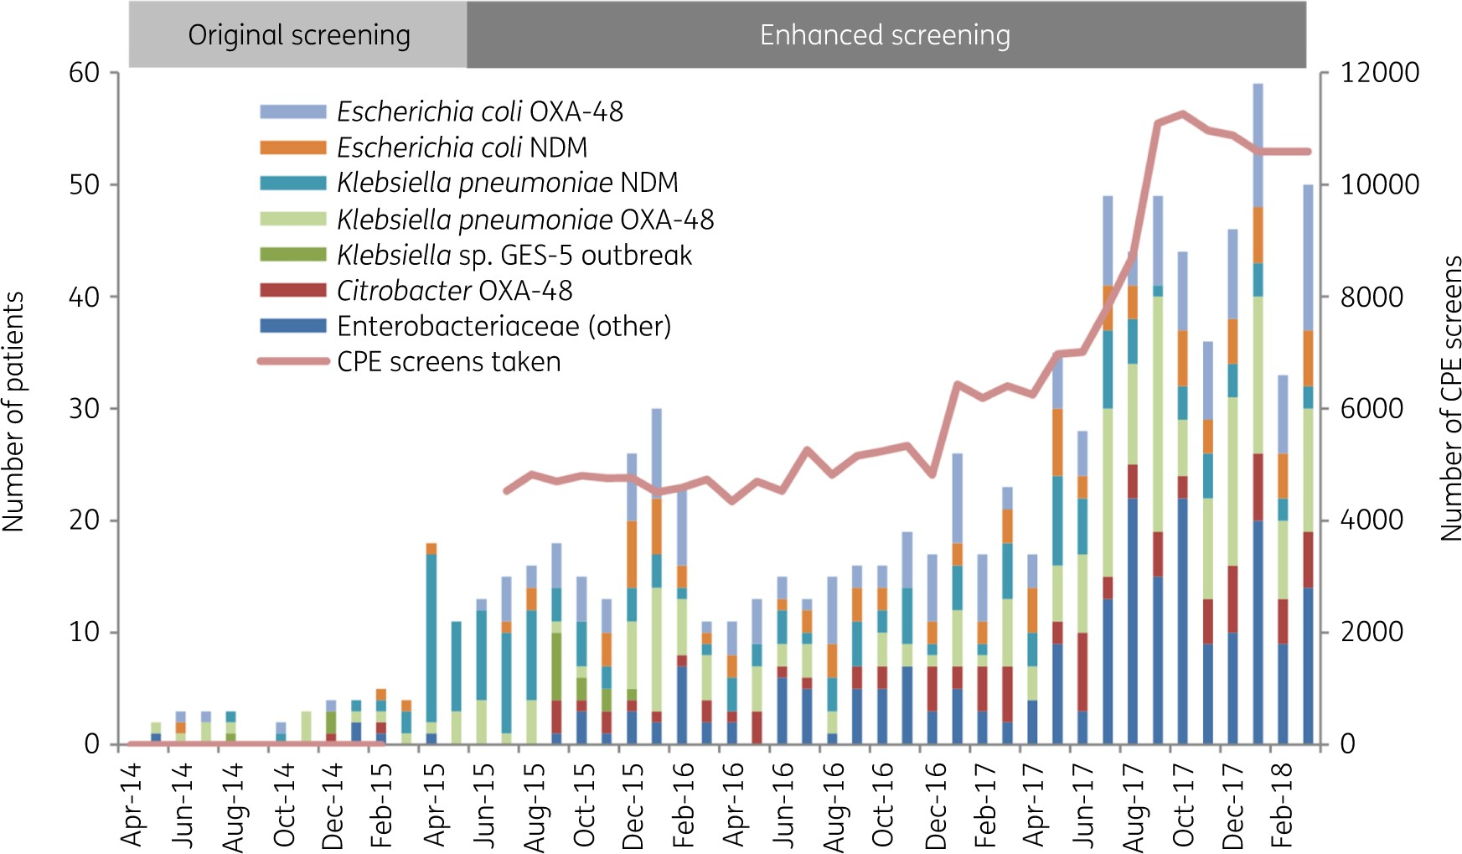
Seek and ye shall find…
Overall trend in CPE detected at the Trust, by bacterial species and mechanisms, deduplicated by patient
Otter et al. J Antimicrob Chemother 2020.

Slide 23
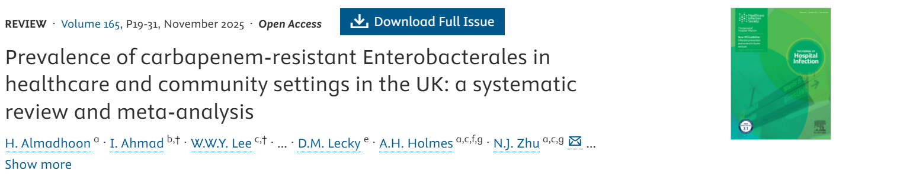
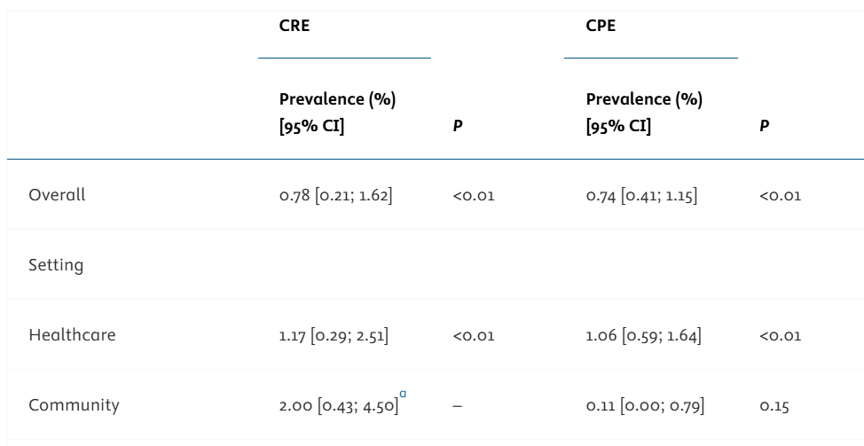

Slide 24
CRE/CPE in the community
Country/Region | Study (year; first author) | Setting & population | Sample size | Screening method | CPE prevalence | Dominant carbapenemase(s)
India | Indian J Med Microbiol (2022; Nasheed Arum et al.) | Healthy community volunteers in Chennai, Hyderabad, Mumbai | 1,000 | chromID CARBA SMART → CARBA NP → multiplex PCR | 6.1% | NDM‑1 (28 isolates) and OXA‑48 (33)
Pakistan (Rawalpindi) | J Antimicrob Chemother (2011; Perry et al.) | Stool from in‑/outpatients at 2 military hospitals; community signal from outpatients | 200 | Colorex KPC vs ID Carba; phenotypic + PCR | Overall 18.5%; outpatients 13.8% | NDM‑1 only detected
Pakistan (Rawalpindi) | PLOS One (2022; Habib et al.) | Rectal swabs at hospital admission (community baseline), then follow‑up during stay | 306 (admission screens) | Ertapenem‑supplemented agar; WGS | 14.4% at admission | Predominantly NDM‑5; also OXA‑181/OXA‑232
Spain (Madrid) | J Clin Microbiol (2012; Gijón et al.) | Mixed hospitalized vs. non‑hospitalized samples; community signal from non‑hospitalized | 1,100 | Enrichment with imipenem → MacConkey; phenotypic assays; gene typing | Non‑hospitalized: 0.4% (overall 1.1%) | Mostly VIM‑1
United Kingdom | J Hosp Infect (2025; Almadhoon et al., systematic review) | Community carriage point‑prevalence (pooled across UK surveys) | N=2,630 (community subset) | Various (culture±PCR), systematic meta‑analysis | 0.11% (95% CI 0.00–0.79) | Varies by study
Ethiopia (Addis Ababa) | BMC Microbiol (2024; Abera et al.) | Healthy community participants (Gulele sub‑city) | 261 | Culture; phenotypic carbapenemase tests; PCR | 0.8% CP‑CRE | Not fully specified; ESBL genes (blaTEM, blaCTX‑M) prevalent
Vietnam (Ha Nam, rural) | Lancet Regional Health–Western Pacific (2025; van Wijk et al.) | Household cross‑sectional rural community | 1,502 | Culture on meropenem/ceftazidime media | CRE: 1.9% | —

Slide 25
What’s the problem?
How bad is it?
How do we stop it?

Slide 26
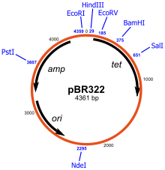
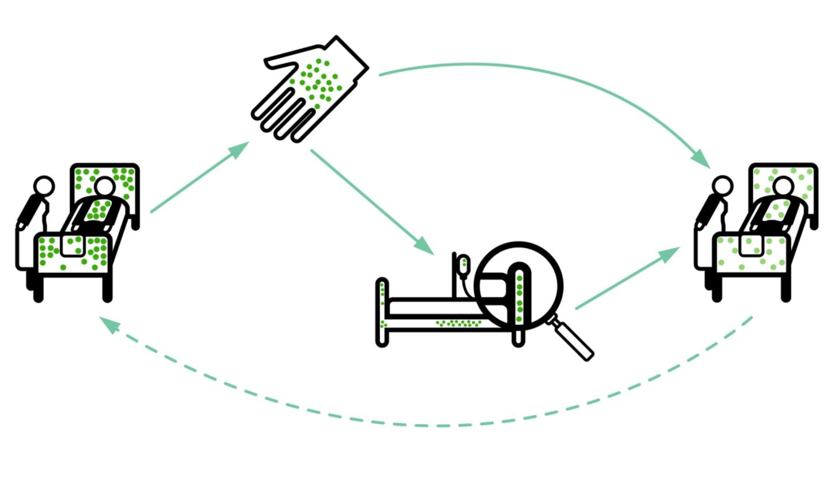

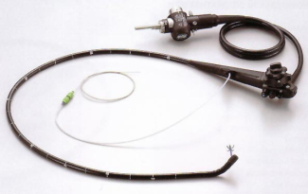
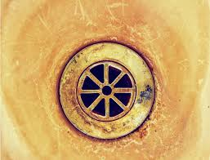
Transmission modes
Otter et al. Infect Control Hosp Epidemiol 2011;32:687-699.

Slide 27
Promiscuous plasmids
Inter-species plasmid transfer of AMR genes was investigated in the 1970s regarding gentamicin-resistance.¹
There are several convincing individual small outbreaks where it is clear that inter-species plasmid transfer of AMR genes has occurred in Gram-negative bacteria.²
In one plasmid outbreak,³ multiple carbapenemases were dealt out like a pack of cards to multiple Enterobacterales species from a single index patient.
More broadly, the population structure of KPC-producing K. pneumoniae is consistent with horizontal gene transfer.^{4,5}
Need to look beyond ‘same-organism-same-gene’ transmission dynamics.
Lee et al. Antimicrob Agents Chemother 1986;29(4):654-9.
Sheppard et al. Antimicrob Agents Chemother 2016;23:3767-78.
Hammerum et al. J Antimicrob Chemother. 2016;71:3117-3124.
Chen et al. Trends Microbiol 2014;22:686-96.
Doumith et al. J Antimicrob Chemother 2017;72:2241-2248.

Slide 28
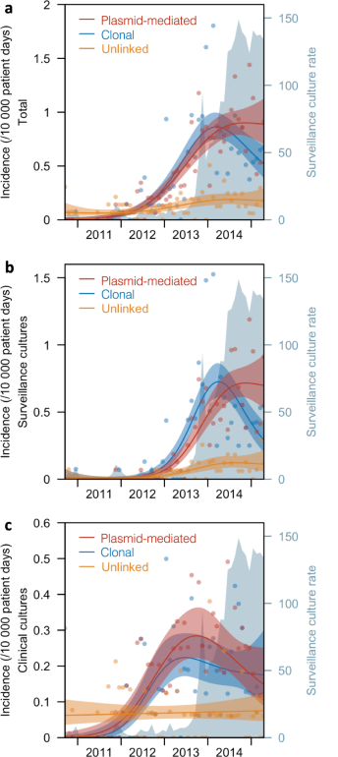
Horizontal plasmid transfer is a key driver of CPE transmission
Genomic analysis of 1312 CPEs submitted to government ref lab in Singapore between 2010 and 2015.
Significant risk factors for clonal spread of CPE:
direct or indirect ward-level contact;
direct or indirect hospital-level contact;
bacterial species (Klebsiella and Enterobacter a higher risk of spread than E. coli;
carbapenemase type (NDM and OXA-type a higher risk of spread than KPC)
Significant risk factors for plasmid-mediated spread of CPE:
none
Marimuthu et al. Nat Comm 2022.

Slide 29
Transmissibility / fitness
Conclusion
Klebsiella species 3.7x more transmissible than E. coli in the ICU.¹
K. pneumoniae seems to be more environmental than E. coli.^{2,3}
Surface contamination on five standardized sites surrounding patients infected or colonized with ESBL-producing Klebsiella spp. (n=48) or ESBL-producing E. coli (n=46).²
p<0.001
p<0.001
1. Gurieva et al. Clin Infect Dis 2018;66:489-93. 2. Guet-Revillet et al. Am J Infect Control 2012;40:845-8.
3. Gbaguidi-Haore. Am J Infect Cont 2013;41:664-5.
Notes:
29
Inter-species variation? Inter-carbapenemase variation?

Slide 30
Tools
Hand hygiene
Contact precautions
Active screening
Antibiotic stewardship
Cleaning / disinfection
Cohorting staff / patients
Note flagging
HCW screening
Education
Env. screening
Decol.
Otter et al. Clin Microbiol Infect 2015 2015;21:1057–1066.

Slide 31
Tools
Hand hygiene
Contact precautions
Active screening
Antibiotic stewardship
Cleaning / disinfection
Cohorting staff / patients
Note flagging
HCW screening
Education
Env. screening
Decol.
Otter et al. Clin Microbiol Infect 2015 2015;21:1057–1066.

Slide 32
Who do I screen?
UKHSA Framework for CPE admission screening triggers, in the last 12 months, they have:
been previously identified as CPE positive
been an inpatient in any hospital, in the UK or abroad
had multiple hospital treatments for example are dialysis dependent
had known epidemiological link to a known carrier of CPE
they are admitted into augmented care or high-risk units

Slide 33
Can I swab your rectum please?
Prospective study of asymptomatic antibiotic-resistant Gram-negative bacteria colonisation in 4006 patients on admission to a London hospital group.
Original description (weeks 1-4)
“Bug”-focussed message
Detailed scientific language
Modified description (weeks 5-14)
Patient-focussed message
“Why is it important to be screened?”
“Benefits for you and those close to you!”
“If you get an infection, we can put you on the right antibiotics straight away.”
Change in description of the study
The change in study description results in a significant reduction in decline rate, from 31.9% of 869 patients to 7.6% of 3690 patients (p <0.001)
Dyakova et al. Clin Microbiol Infect. 2017;23:577.e1-577.e3.

Slide 34
Colonisation often precedes infection for MDROs
Meta-analyses of subsequent infection in patients first identified as colonised with CPE/VRE.
 |  | Any infection |  |  | Bloodstream infection
 |  | N studies | N infected / N colonised | Cumulative incidence (95% CI), % | N studies | N infected / N colonised | Cumulative incidence (95% CI), %
MDR-GNB |  | 32 | 845/9034 | 0·14 (0·10–0·18) | 23 | 434/8307 | 0·07 (0·04–0·11)
CRE or CPE |  | 19 | 602/4547 | 0·19 (0·15–0·25) | 14 | 347/4142 | 0·10 (0·07–0·15)
ESBL-E or 3GCR-E |  | 14 | 235/4461 | 0·08 (0·05–0·13) | 9 | 70/4087 | 0·04 (0·02–0·07)
 | E. coli | 7 | 133/3098 | 0·08 (0·04–0·14) | 6 | 46/3042 | 0·04 (0·01–0·10)
 | K. pneumoniae | 4 | 59/741 | 0·09 (0·06–0·13) | 3 | 14/730 | 0·02 (0·01–0·05)
VRE |  | 16 | 329/5015 | 0·07 (0·04–0·12) | 10 | 163/1840 | 0·10 (0·06–0·16)
Incidence for CP-CRE was 26% (95% CI 19–35)
Willems et al. Lancet Infect Dis 2023.

Slide 35
Tools
Hand hygiene
Contact precautions
Active screening
Antibiotic stewardship
Cleaning / disinfection
Cohorting staff / patients
Note flagging
HCW screening
Education
Env. screening
Decol.
Otter et al. Clin Microbiol Infect 2015 2015;21:1057–1066.

Slide 36
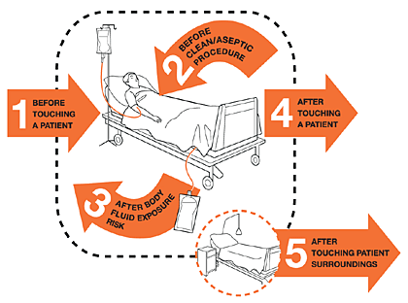
Contaminated hands
40%
Erasmus et al. Infect Control Hosp Epidemiol 2010;31:283-94.

Slide 37
Tools
Hand hygiene
Contact precautions
Active screening
Antibiotic stewardship
Cleaning / disinfection
Cohorting staff / patients
Note flagging
HCW screening
Education
Env. screening
Decol.
Otter et al. Clin Microbiol Infect 2015 2015;21:1057–1066.

Slide 38
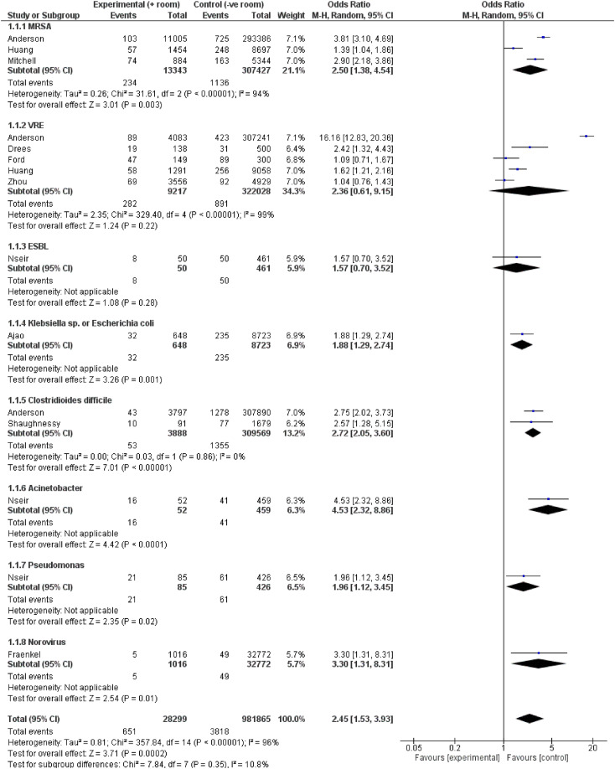
The MDRO status of the prior room occupant influences acquisition risk
Meta-analysis of studies evaluating the risk of MDRO acquisition for the incoming occupant based on the status of the prior room occupant.
 | OR | 95% CI
Acinetobacter | 4.5 | 2.3-8.9
Norovirus | 3.3 | 1.3-8.3
C. difficile | 2.7 | 2.0-3.6
MRSA | 2.5 | 1.4-4.5
VRE | 2.4 | 0.6-9.1
Pseudomonas | 2.0 | 1.1-3.4
Klebsiella or E. coli | 1.9 | 1.3-2.7
ESBL | 1.6 | 0.7-3.5
Total | 2.5 | 1.5-3.9
Mitchell et al. Infect Dis Health 2023.

Slide 39

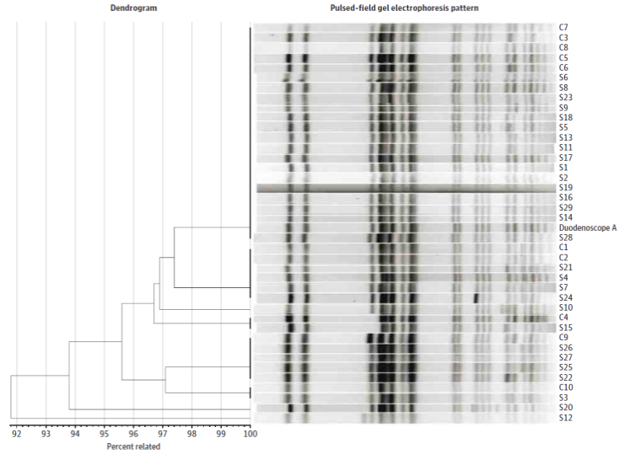
When medical device decon fails…
39 patient CRE outbreak in 2013 in Illinois.¹
Odds ratio for duodenoscope exposure in case patients 78 (95% CI 6-1008).
No breakdown in compliance with decon procedures; has prompted a global review and change in the way that these devices are decontaminated.²
Meticulously cleaning duodenoscopes prior to high-level disinfection should reduce the risk of transmitting infection, but may not entirely eliminate it. (FDA Feb 23 2015).
Epstein et al. JAMA. 2014;312:1447-55.
Rutala & Weber. Am J Infect Control 2016;44 (Suppl):e47-51

Slide 40
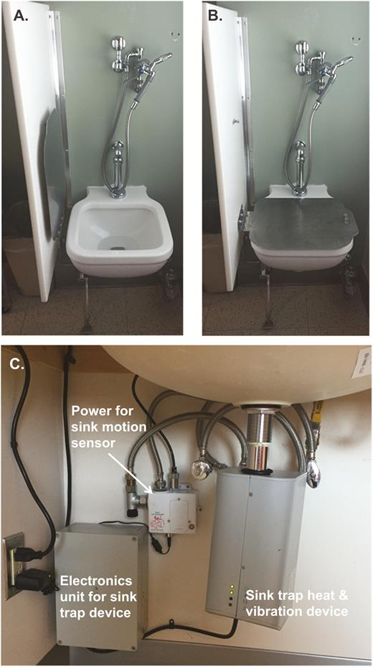
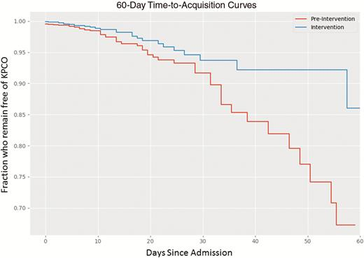
Contaminated sinks / drains
CPE (K. pneumoniae) acquisition and clinical infection halved through improved management of sinks (OR = 0.51 for acquisions, and 0.29 for clinical cultures) (n=~7,500 pts).
Mathers et al. Clin Infect Dis 2018 in press.

Slide 41
Tools
Hand hygiene
Contact precautions
Active screening
Antibiotic stewardship
Cleaning / disinfection
Cohorting staff / patients
Note flagging
HCW screening
Education
Env. screening
Decol.
Otter et al. Clin Microbiol Infect 2015 2015;21:1057–1066.

Slide 42
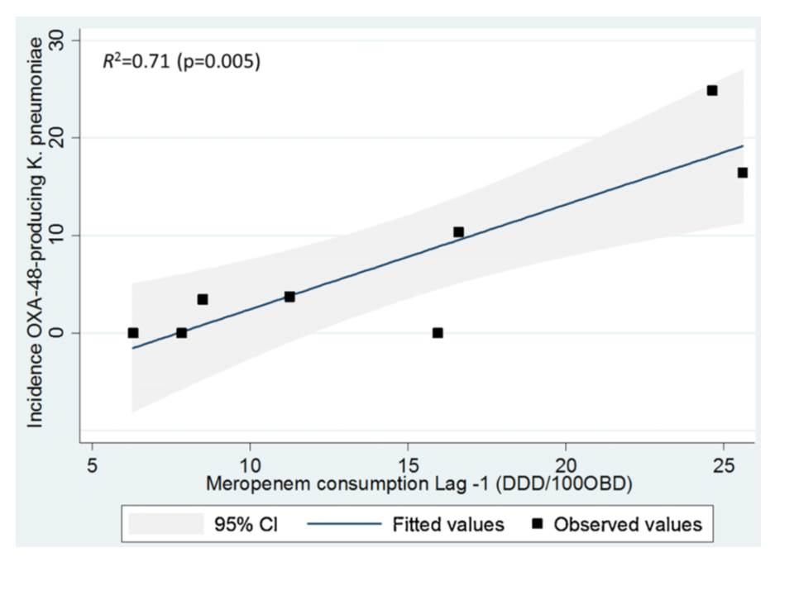
Can we forecast a CPE storm?
Could we find and implement an “alert” level of carbapenem use?
The paper reports that a stewardship intervention brought the CPE outbreak under control – but also implemented ‘case isolation, screening of contacts, barrier nursing and other infection control interventions’.
Study focussed only on OXA-48 K. pneumoniae; what about other Enterobacterales and non-fermenters?
What drives carbapenem resistance? The use of meropenem in the previous year plotted against the incidence rate of OXA-48-producing K. pneumoniae
Gharbi et al. Int J Antimicrob Agents 2015.

Slide 43
Antibiotic use
Evaluating impact of 6 month antimicrobial stewardship intervention on an ICU by comparing bacterial resistance for matched 6 month periods either side of intervention.
*
*
*
*
*
*
Hou et al. PLoS ONE 2014;9:e101447; * = significant difference before vs. after.

Slide 44
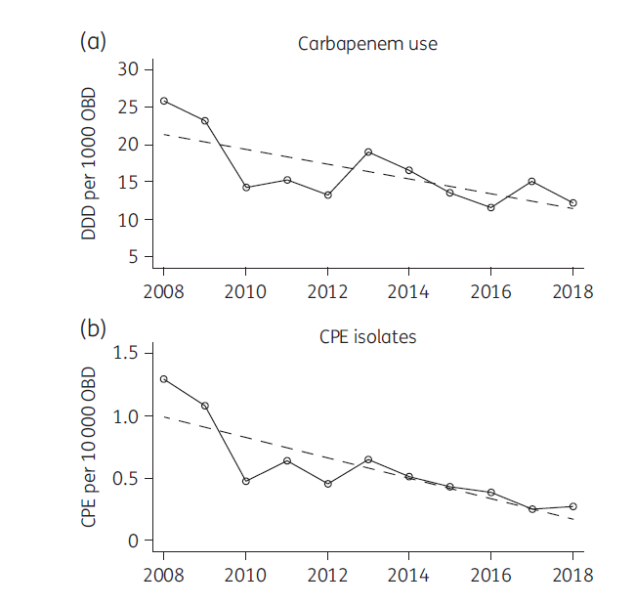
Antibiotic use
Impact of an antimicrobial stewardship programme on carbapenem consumption and CPE in an Australian local health district.
Cipko et al. J Antimicrob Chemother AMR 2020.

Slide 45
Tools
Hand hygiene
Contact precautions
Active screening
Antibiotic stewardship
Cleaning / disinfection
Cohorting staff / patients
Note flagging
HCW screening
Education
Env. screening
Decol.
Otter et al. Clin Microbiol Infect 2015 2015;21:1057–1066.

Slide 46
Deisolation?
Author | Year | Setting | N pts | Organism | Duration of colonization
Bird¹ | 1998 | Elderly care facilities, Scotland | 38 | ESBL K. pneumoniae | Mean 160 days (range 7-548)
Pacio² | 2003 | Long term care facility, USA | 8 | Resistant Gram-negative rods | Median 77 days (range 47-189)
Zahar³ | 2010 | Paediatric hospital, France | 62 | ESBL Enterobacteriaceae | Median 132 days (range 65-228)
O'Fallon⁴ | 2009 | Long term care facility, USA | 33 | Resistant Gram-negative rods | Median 144 days (range 41–349)
Zimmerman⁵ | 2013 | Patients discharged from hospital, Israel | 97 | CRE | Mean 387 days
Bird et al. J Hosp Infect 1998;40:243-247.
Pacio et al. Infect Control Hosp Epidemiol 2003;24:246-250.
Zahar et al. J Hosp Infect 2010;75:76-78.
O'Fallon et al. Clin Infect Dis 2009;48:1375-1381.
Zimmerman et al. Am J Infect Control 2013;41:190-194.

Slide 47
‘Selective’ digestive decontamination
20 CRE colonized patients in each arm given gentamicin + polymyxin (SDD arm) or placebo (Control arm)
Saidel-Odes et al. Infect Control Hosp Epidemiol 2012;33:14-19.

Slide 48
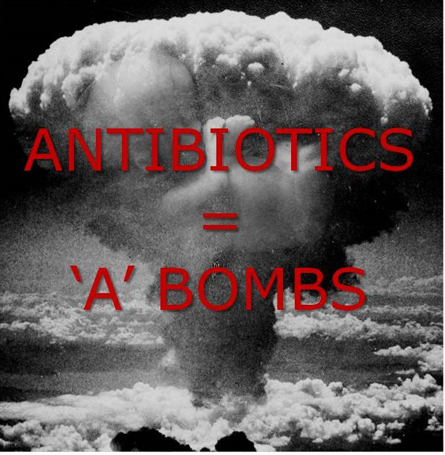
Notes:
Antibiotics have a profound and sustained effect on the human microbiome (even those that are typically associated with no or few side effects). This results in a reduction in both diversity and change in composition, which is bad news for human health. In particular, this leave the gut more open to colonization with unwanted intruders aka antibiotic resistant bacteria.

Slide 49
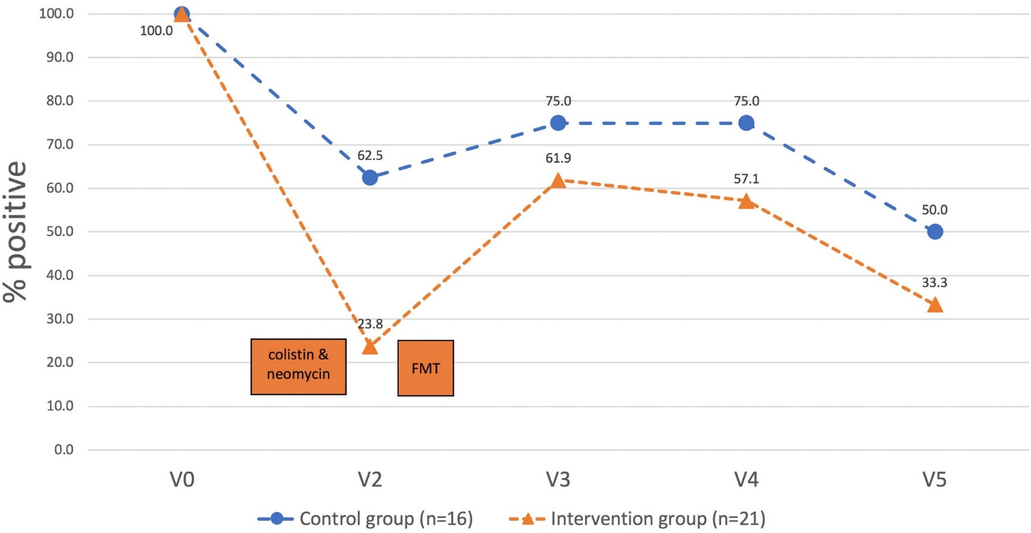
Decolonisation using FMT
39 ESBL or CPE colonized patients randomised to oral abx + FMT (brown(!) line) or no intervention (blue line)
Huttner et al. Clin Microbiol Infect 2019.

Slide 50
Chlorhexidine – efficacy
Impact of chlorhexidine gluconate (CHG) daily bathing on skin colonization with KPC-producing K. pneumoniae in 64 long-term acute care patients.
Lin et al. Infect Control Hosp Epidemiol 2014; 35:440-442.

Slide 51

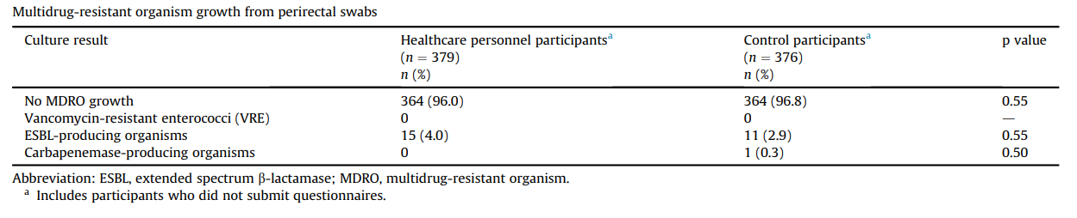
Colonised staff?
Decker et al. Clin Microbiol Infect 2018;24:82.e1-82.e4.

Slide 52
Carbapenem-resistant Enterobacterales in healthcare and community settings
Jon Otter PhD FRCPath,
Director of Infection Prevention and Control & Consultant Clinical Scientist
Guy’s and St Thomas’ NHS Foundation Trust
Honorary Senior Lecture in HCAI & AMR, Imperial College London
@jonotter
@jon-otter.bsky.social
j.otter@imperial.ac.uk

