Slide 1
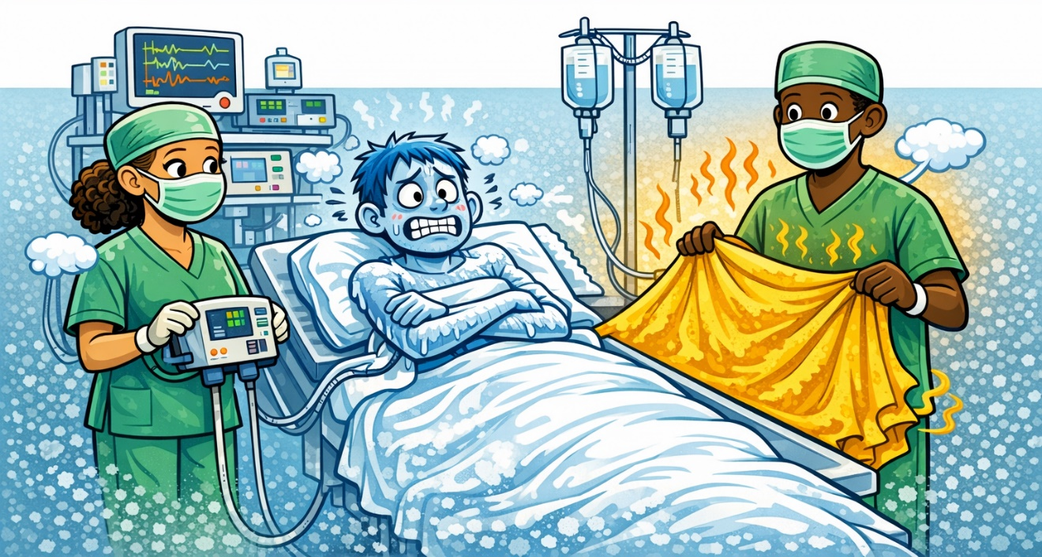





Optimising perioperative quality: the role of patient warming
Scan me for Mentimeter polls!
Jon Otter PhD FRCPath FIBMS
Director of Infection Prevention and Control & Consultant Clinical Scientist
Guy’s and St Thomas’ NHS Foundation Trust
Honorary Senior Lecture in HCAI & AMR, Imperial College London
@jonotter
@jon-otter.bsky.social
jon.otter@nhs.net

Slide 2
Which is the most common HCAI in terms of prevalence?
UTI
BSI
SSI
Lower RTI
C. difficile infection

Slide 3
Why SSIs are important
Preventing SSI
Normothermia
Patient warming

Slide 4
Infections related to surgery vs. SSI
SSI
Respiratory infections (HAP, VAP)
Urinary tract infections
Invasive infections
DRIs

Slide 5
SSI
Patient experience
Costs
Reputation/ patient choice
Antimicrobial resistance

Slide 6
Patient experience
17 patients who had suffered an SSI were enrolled into a semi-structured interview
‘I was crying, I was just not well at all. I couldn’t keep a drink down. The GP came and said what do you expect, you’ve had major surgery. I started to think I was going mad, perhaps you are supposed to feel like this. My husband was at his wits end, he didn’t know what to do. He called the NHS helpline and they said to buy some anti-sickness tablets from the chemist but they didn’t work. He rang the hospital and they weren’t very helpful, he rang the ward and they said she has been discharged so there is nothing we can do. Then after three or four days I was getting terrific pains in my stomach and I felt like I had wet myself, there was a lot of blood just gushing out of me.’
Tanner et al. J Infect Prevent 2012

Slide 7
Economic burden and perspectives
Hospital
Payer/healthcare system
Societal
Economic
Patient
CEO
CFO
Clinical team

Slide 8
Cost of SSI
Direct costs
Indirect costs
ICU stay
Repeated surgery
Hospital readmission
Medical costs
Investigation/diagnostics
Staff time
Hospital overheads
Antibiotics
Increased length of stay
Morbidity & mortality
Decrease in quality of life
Loss of earnings
Iskander et al. World J Emerg Surg 2019

Slide 9
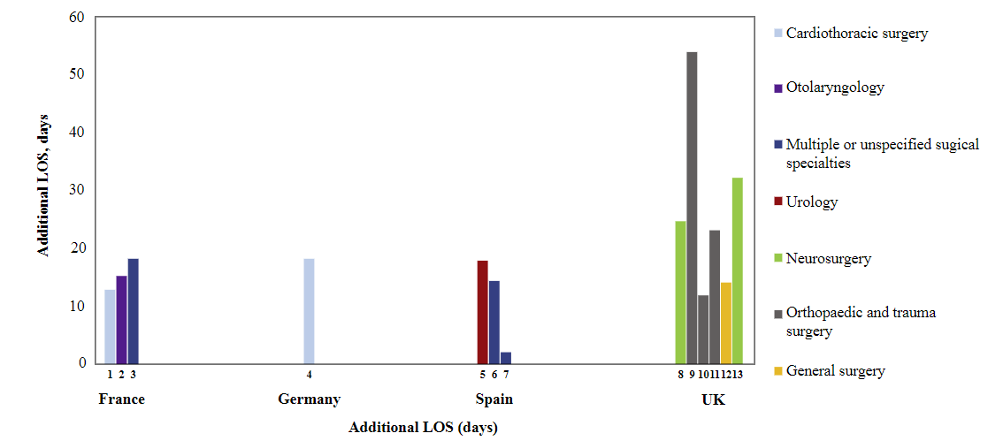
Cost of SSI – extended length of stay
Badia et al. J Hosp Infect 2017

Slide 10
Category | Median cost attributable to SSI (95% CI)
Cardiac | £11,003 (8,517–15,395)
Vascular | £2,480 (–757 to 9,209)
Limb amputation | £6,799^{c}
Hip replacement | £3,214 (657–17,040)
Knee replacement | £2,356^{c}
Reduction long bone fracture | £4,982 (284–11,873)
Repair neck of femur | £12,104^{c}
Cranial | £2,662 (5–20,297)
Spinal | £7,076 (3,391–17,945)
Abdominal hysterectomy | £5,983^{c}
Caesarean section | £3,716 (894–4,905)
Breast | £1,469 (1,123–4,058)
Bile duct, liver, pancreatic | £2,838 (–141 to 14,218)
Cholecystectomy | £6,236^{c}
Gastric | £21,493^{c}
Large bowel | £4,928 (4,020–7,503)
Small bowel | £6,198 (–424 to 9,254)
Multiple intra-abdominal | £1,495 (–3,121 to 11,712)
Multiple other procedures | £9,696^{c}
All categories | £5,239 (4,622–6,719)
Adapted from Jenks et al. J Hosp Infect 2014

Slide 11
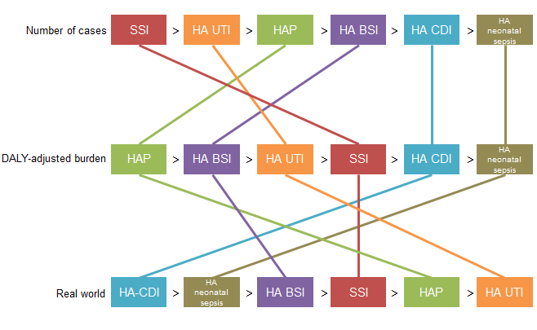
Cost of SSI
Cassini et al. Plos Med 2016.

Slide 12
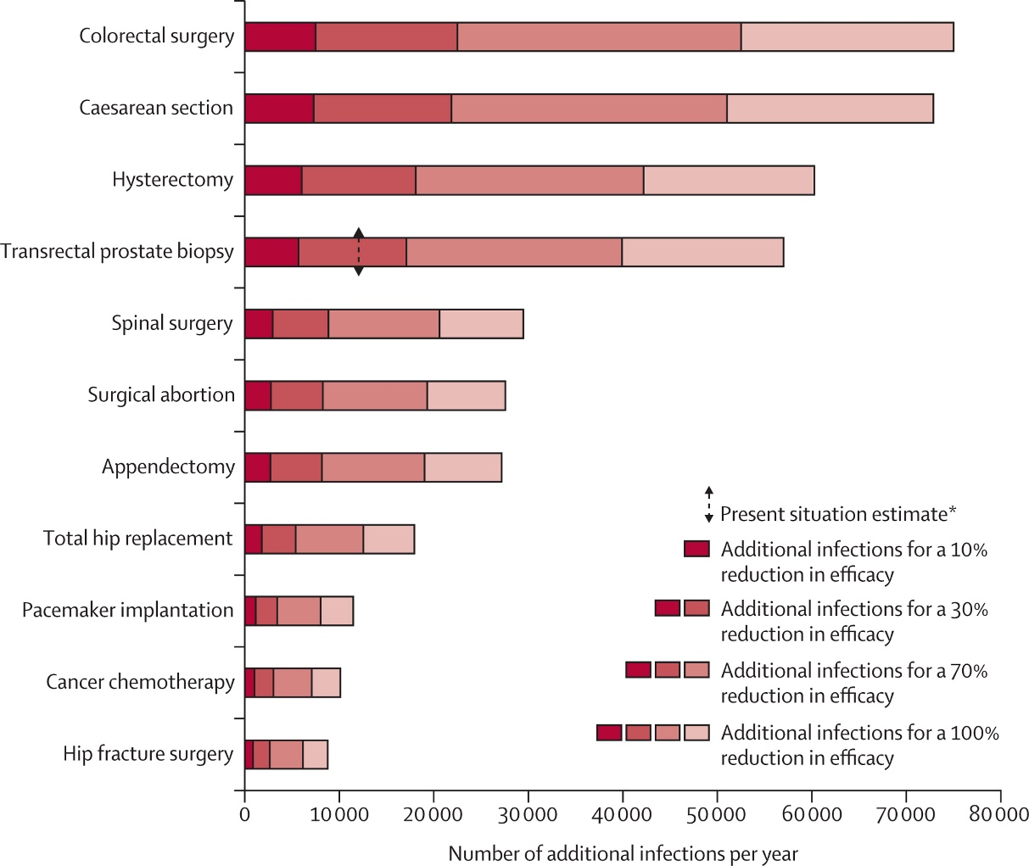
Antimicrobial resistance and SSI
Teillant et al. Lancet Infect Dis 2015.

Slide 13

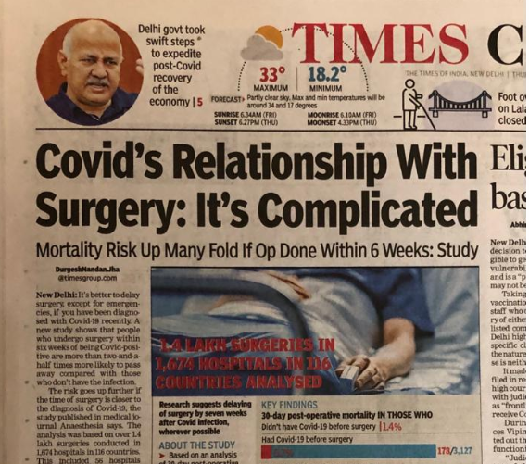
Reputation…and patient choice

Slide 14
Why SSIs are important
Preventing SSI
Normothermia
Patient warming

Slide 15
Rank these SSI-prevention measures by way of impact
Wound dressing
Maintaining normothermia
Wound closure
Antibiotic prophylaxis

Slide 16
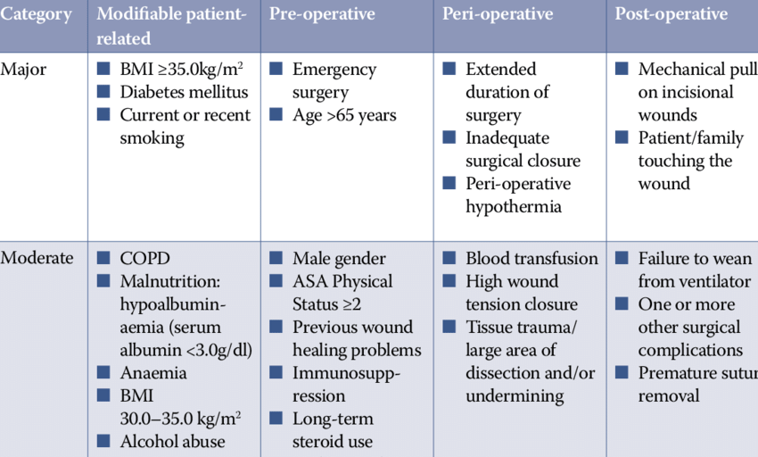
Risk factors for SSI
Younis et al. Wounds UK 2020.

Slide 17
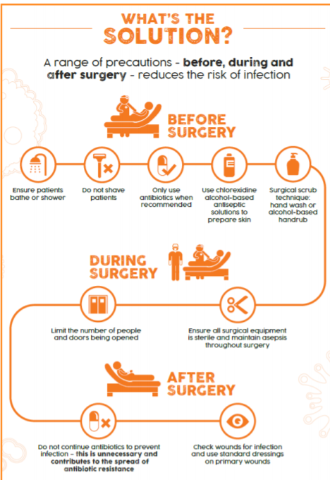
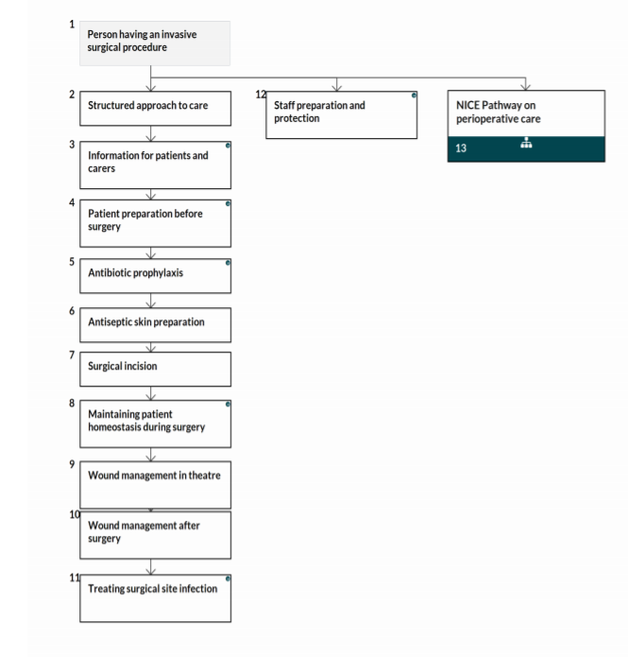
The building blocks of SSI prevention
NICE pathways
https://www.theific.org/wp-content/uploads/2017/10/36.pdf

Slide 18
Information for patients
Pre-operative
Intra-operative
Post-operative
Pre-operative bathing
Nasal decolonisation
Hair removal
Incise drapes
Antibiotic prophylaxis
Antiseptic skin prep
Patient homeostasis
Wound closure
Wound care
Patient warming

Slide 19
Why SSIs are important
Preventing SSI
Normothermia
Patient warming

Slide 20
What is hypothermia?
Hypothermia is defined as a core temperature below 36°C and is common during and after major surgical procedures lasting more than 2 hours

Slide 21
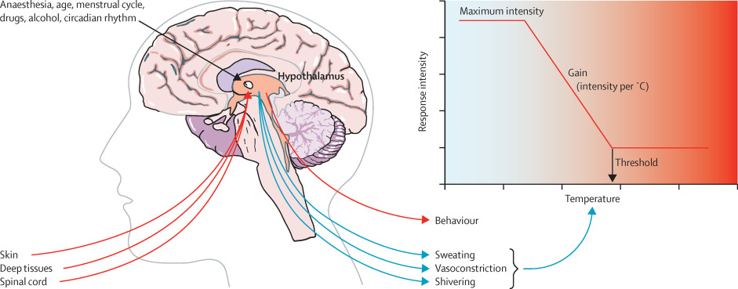
What causes hypothermia?
Anaesthetic-induced impairment of thermoregulatory control is the most common events leading to hypothermia
Sessler. Lancet 2016

Slide 22
Poll
How common is hypothermia?

Slide 23
How common is it?
It is estimated that 30-53% of patients experience hypothermia during major surgery, and this varies by surgical category
Alfonsi et al. Plos One 2019.

Slide 24
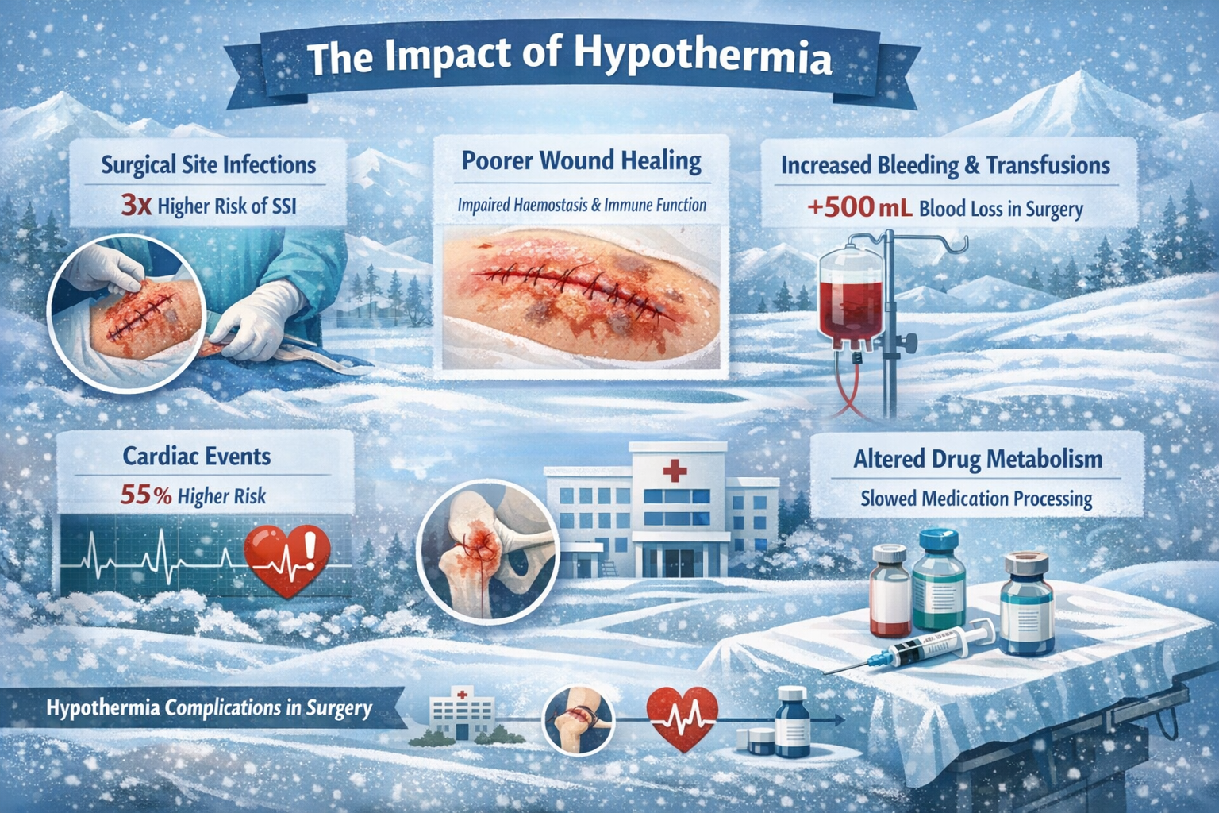
Notes:
Refs Kurz A, Sessler DI, Lenhardt R. Perioperative normothermia to reduce the incidence of surgical-wound infection and shorten hospitalization. Study of Wound Infection and Temperature Group. N Engl J Med. 1996 May 9;334(19):1209-15.
Pietsch AP, Lindenblatt N, Klar E. Perioperative hypothermia. Impact on wound healing. Anaesthesist. 2007 Sep;56(9):936-9.
Schmied H, Kurz A, Sessler DI, Kozek S, Reiter A. Mild hypothermia increases blood loss and transfusion requirements during total hip arthroplasty. Lancet. 1996 Feb 3;347(8997):289-92. doi: 10.1016/s0140-6736(96)90466-3.
Frank SM, Fleisher LA, Breslow MJ, Higgins MS, Olson KF, Kelly S, Beattie C. Perioperative maintenance of normothermia reduces the incidence of morbid cardiac events. A randomized clinical trial. JAMA. 1997 Apr 9;277(14):1127-34.
Zhou J, Poloyac SM. The effect of therapeutic hypothermia on drug metabolism and response: cellular mechanisms to organ function. Expert Opin Drug Metab Toxicol. 2011 Jul;7(7):803-16. doi: 10.1517/17425255.2011.574127.

Slide 25
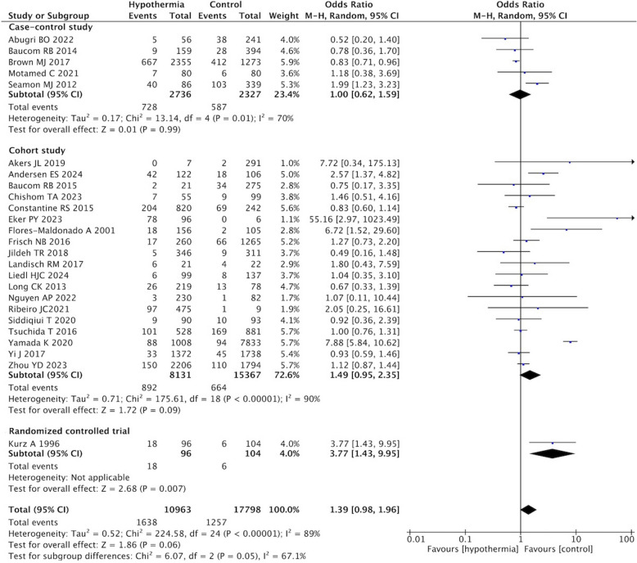
Hypothermia – impact – SSI
Systematic review and meta-analysis of 25 studies.
Chen et al. BMC Anaesthesiol 2025.

Slide 26
Core vs. non-core temperature
Aspect | Core temperature | Non-core temperature
Accuracy | High (true internal temperature) | Lower; can deviate 0.5–2°C
Reliability in surgery | Reliable during anaesthesia | Affected by perfusion & environment
Clinical use | Guides perioperative decisions | Mainly screening/trending
Invasiveness | Can be invasive / semi-invasive | Non-invasive (e.g. intrared)
Key limitation | Practicality, invasiveness, cost | Risk of inaccurate readings

Slide 27
Ways to measure core temperature
Measure the patient's temperature using a site that produces either:
a direct measurement of core temperature, or
a direct estimate of core temperature that has been shown in research studies to be accurate to within 0.5ºC of direct measurement; a direct estimate of core temperature is the reading produced by a thermometer with no correction factors applied.
At the time of publication these sites are: pulmonary artery catheter, distal oesophagus, urinary bladder, zero heat-flux (deep forehead), sublingual*, axilla* rectum. [new 2016]
Do not use indirect estimates of core temperature in adults having surgery. An indirect estimate of core temperature is the reading produced by a thermometer after a correction factor has been applied. Examples include infrared tympanic, infrared temporal, infrared forehead and forehead strips. [new 2016]
* be aware of possible inaccuracies in core temperature estimation when using peripheral sites, such as sublingual or axilla, in patients whose core temperature is outside the normothermic range (36.5°C to 37.5°C).
NICE CG65: Hypothermia: prevention and management in adults having surgery

Slide 28
Challenges with core temperature monitoring
Lack of ownership and accountability
Inconsistent methods across the patient pathway
Practical and technical limitations
Incorrect probe placement is common, particularly with nasopharyngeal devices, leading to inaccurate readings.
Paper-based records limit visibility of trends and make auditing difficult.
Non-integrated devices may require manual transcription, creating errors and inefficiencies.
Resource constraints mean that not all patients undergoing surgery are provided with continuous monitoring, even when recommended.
Time pressures and workflow disruptions
Education and cultural barriers
Infrastructure and environmental factors

Slide 29
Please rank the following challenges to measuring core temperature
Lack of ownership and accountability
Inconsistent methods across the patient pathway
Practical and technical limitations
Time pressures and workflow disruptions
Education and cultural barriers
Infrastructure and environmental factors

Slide 30
Why SSIs are important
Preventing SSI
Normothermia
Patient warming

Slide 31
Guidelines
NICE Clinical Guideline CG65: Published in 2008 and updated in 2016, NICE CG65 recommends that all surgical patients should have their core temperature measured before induction of anaesthesia and regularly throughout surgery. Active warming should be used for patients at risk of hypothermia, with pre-warming of at least 30 minutes for those entering theatre with a temperature below 36.0°C.
‘One Together’ resources: Developed collaboratively by the Association for Perioperative Practice (AfPP), Infection Prevention Society, and others, this initiative provides practical tools, checklists, and care bundles that support frontline teams in SSI prevention, including maintaining normothermia.
World Health Organization (WHO) and Centre for Disease Control (CDC) guidelines: Both WHO and CDC recommend maintaining perioperative normothermia as part of a core SSI prevention bundle, underlining its global relevance.
Association for Perioperative Practice (AfPP): Offers UK-specific standards of perioperative care, reinforcing the role of pre-warming, intraoperative warming, and reliable monitoring.

Slide 32
Achieving and maintaining normothermia
Approach | Pros | Cons / Limitations
Forced-air warming | - Most widely adopted method for prewarming - Strong evidence of effectiveness, even with short (10–20 min) pre-op use - Often considered the “gold standard” in perioperative practice | - Requires dedicated equipment - Dependent on workflow and setup time
Conductive warming (resistive/mattress/water devices) | - Direct heat transfer via pads/mattresses - Can achieve similar outcomes to forced-air when used properly | - Effectiveness depends on correct application - No clear advantage over forced-air
Radiant warming | - Effective in neonatal and paediatric populations - Useful where maintaining normothermia is particularly challenging | - Mainly limited to neonatal/paediatric settings - Less commonly used in adult perioperative care
Combination (multimodal) approaches | - More effective than single methods - Helps maintain more stable core temperature throughout the pathway - Particularly beneficial for high-risk patients or long procedures | - More complex to implement - Requires coordination across perioperative phases - Greater resource and workflow demands

Slide 33
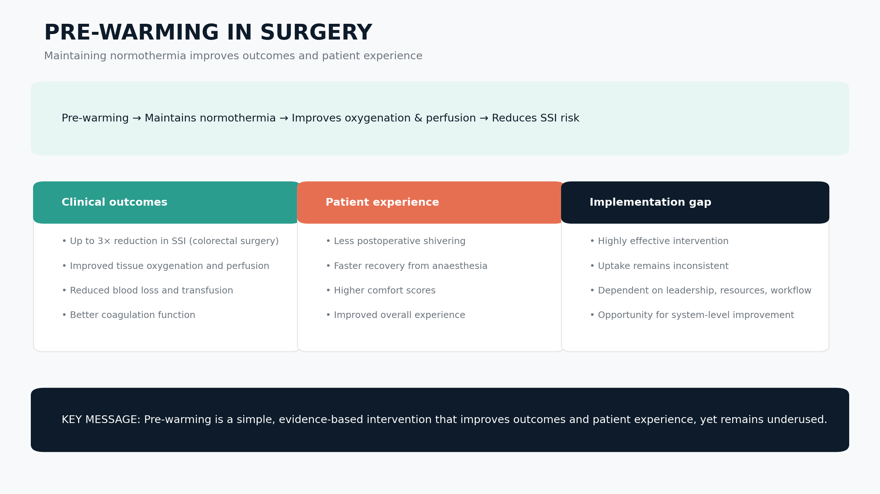
Benefits of pre-warming
Notes:
Kurz et al. N Engl J Med 1996.
Rajagopalan et al. Anesthesiology 2008.
Munday et al. JBI Database System Rev Implement Rep 2019.

Slide 34
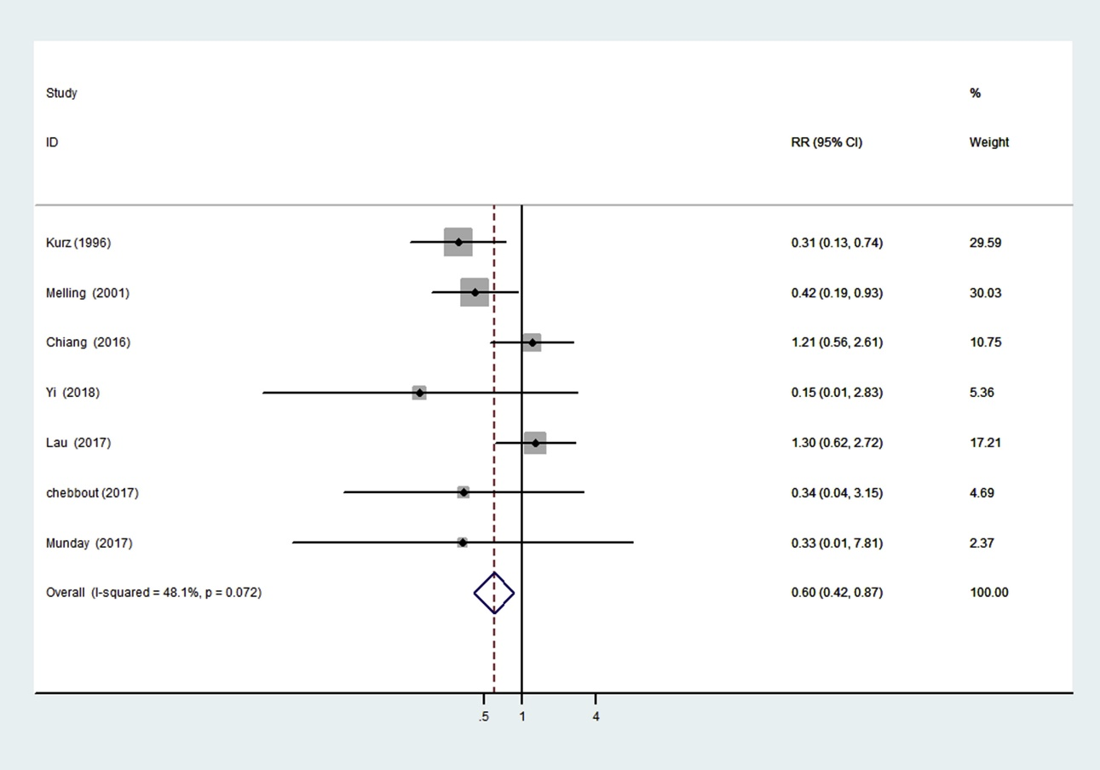
Patient warming and SSI risk
Systematic review and meta-analysis of patient warming and SSI risk.
Webster & Alghamdi. Cochrane Database of Systematic Reviews 2015.

Slide 35
Why SSIs are important
Preventing SSI
Normothermia
Patient warming

Slide 36
Optimising perioperative quality: the role of patient warming
Jon Otter PhD FRCPath FIBMS
Director of Infection Prevention and Control & Consultant Clinical Scientist
Guy’s and St Thomas’ NHS Foundation Trust
Honorary Senior Lecture in HCAI & AMR, Imperial College London
@jonotter
@jon-otter.bsky.social
jon.otter@nhs.net

