Slide 1
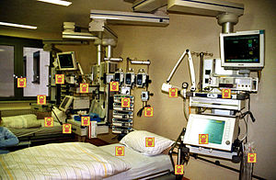




The role of cleaning and disinfection in preventing HCAI
Jon Otter PhD FRCPath FIBMS
Director of Infection Prevention and Control & Consultant Clinical Scientist
Guy’s and St Thomas’ NHS Foundation Trust
Honorary Senior Lecture in HCAI & AMR, Imperial College London
Co-founder IPC Partners
@jonotter
jon.otter@nhs.net

Slide 2





Slide 3


Slide 4
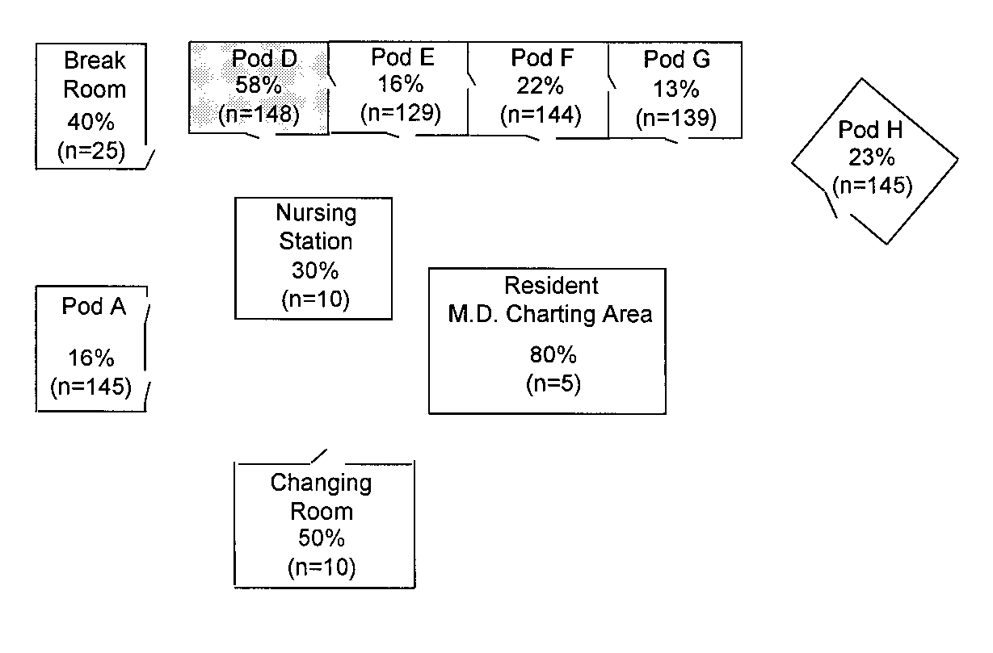
Transfer of a surrogate marker in a NICU
Oelberg et al. Pediatrics 2000;105:311-315.

Slide 5
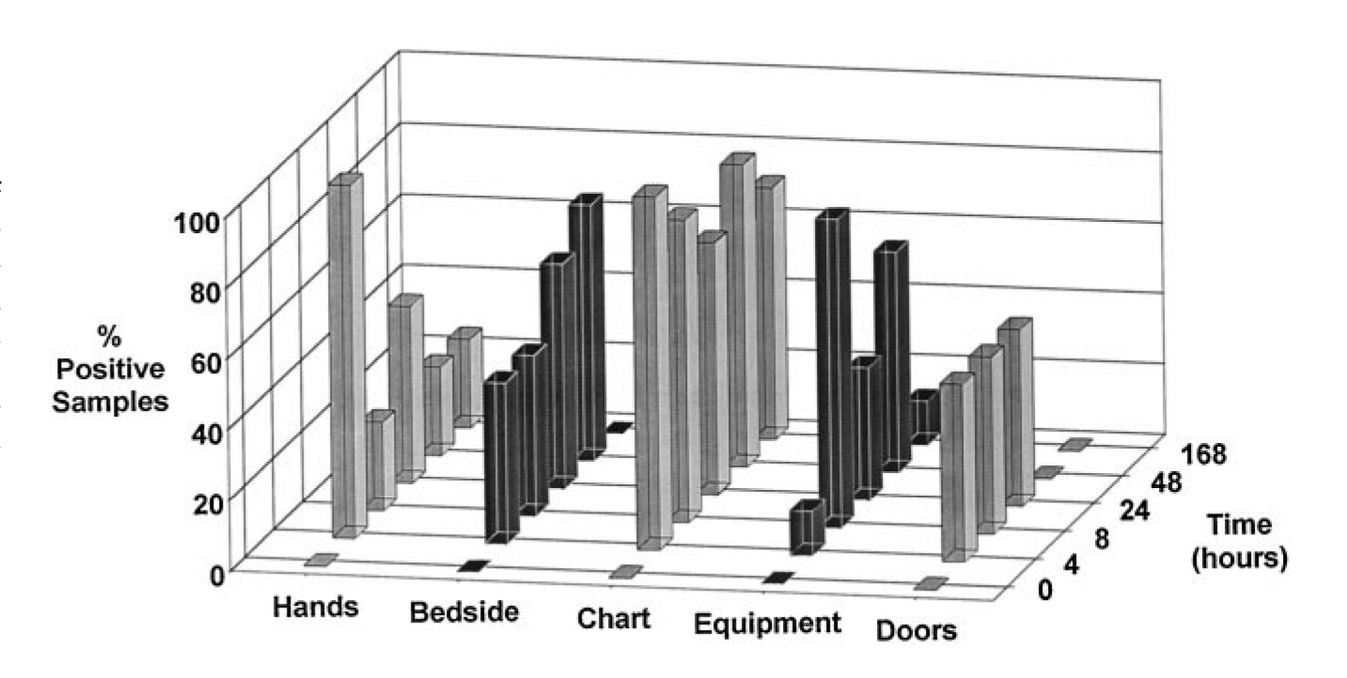
Transfer over time: inoculated pod

Slide 6
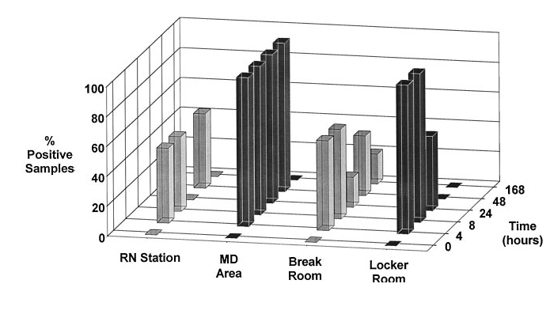
Contamination over time by location

Slide 7
Importance of surface contamination for HCAI and AMR
Current approaches to cleaning and disinfection
Contaminated sinks and drains

Slide 8
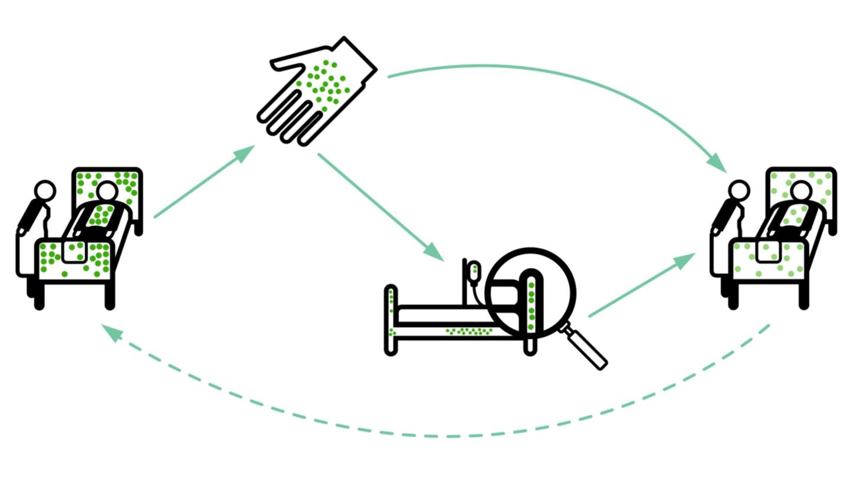
Transmission routes
Otter et al. Infect Control Hosp Epidemiol 2011;32:687-699.

Slide 9
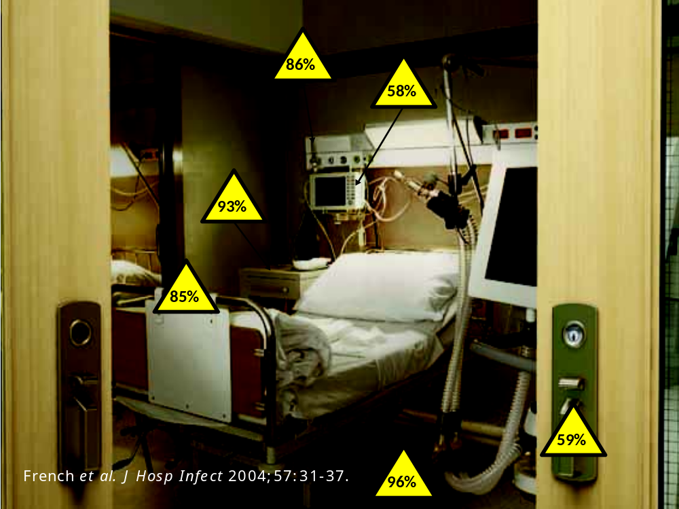

Slide 10
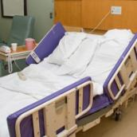
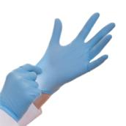
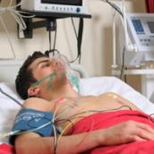
Surface <> Hand <> Patient
²
Pathogens can be transferred from surfaces to HCW hands
without direct patient contact¹
52% of 23 HCW acquired VRE on their hands³ | Contact with patient or surface = ~10% risk of acquiring VRE³
45% of 50 HCW acquired MRSA on their hands⁴ | 40% of 50 HCW acquired MRSA on their hands⁴
50% of 30 HCW acquired C. difficile on their hands⁵ | 50% of 30 HCW acquired C. difficile on their hands⁵
Compliance with hand hygiene: 50%⁶ | Compliance with hand hygiene: 80%⁶
Boyce et al. Infect Control Hosp Epidemiol 1997;18:622-627.
Bhalla et al. Infect Cont Hosp Epidemiol 2004;25:164-167.
Hayden et al. Infect Control Hosp Epidemiol 2008;29:149-154.
Stiefel et al. Infect Control Hosp Epidemiol 2011;32:185-187.
Guerrero et al. Am J Infect Control 2012;40:556-558.
Randle et al. J Hosp Infect 2010;76:252-255.

Slide 11
Surface survival
Organism | Survival time
Clostridium difficile (spores) | 5 months
Acinetobacter spp. | 3 days to 5 months
Enterococcus spp. including VRE | 5 days – 4 years (!)¹
Pseudomonas aeruginosa | 6 hours – 16 months
Klebsiella spp. | 2 hours to > 30 months
Staphylococcus aureus, inc. MRSA | 7 days – 7 months
Norovirus (and feline calicivirus) | 8 hours to > 2 weeks²
SARS Coronavirus | 72 hours to >28 days³
Influenza | Hours to several days⁴
Adapted from Kramer et al. BMC Infect Dis 2006;6:130.
Wagenvoort et al. J Hosp Infect 2011;77:282-283.
Doultree et al. J Hosp Infect 1999;41:51-57.
Rabenau et al. Med Microbiol Immunol 2005;194:1-6.
Bean et al. J Infect Dis 1982;146:47-51.

Slide 12
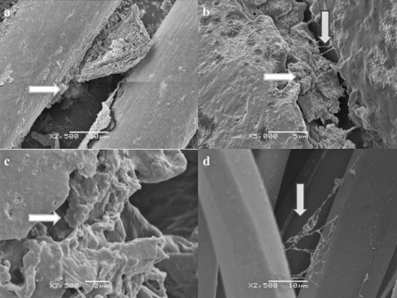
Rethinking the ‘inanimate’ environment
Scanning electron microscopy identified biofilm on 5/6 dry hospital surfaces from an Australian ICU (including MRSA on 3/5).¹
Followup study identified biofilm on 41/44 (93%) of surfaces in an ICU; MRSA from 18%, ESBL from 11% and VRE from 8% of the samples.²
Could explain why vegetative bacteria can survive on dry hospital surfaces for so long
Be part of the reason why they are so difficult to remove or inactivate using disinfectants
Explain (to some degree) the difficulty in recovering environmental pathogens by surface sampling
1. Vickery et al. J Hosp Infect 2012;80:52-55.
2. Hu et al. J Hosp Infect 2015;91:35-44.

Slide 13
Conventional terminal cleaning / disinfection
Notes:
Studies that have evaluated the effectiveness of terminal cleaning and disinfection have consistently demonstrated that conventional methods fail to eliminate reliably contamination with pathogens.

Slide 14
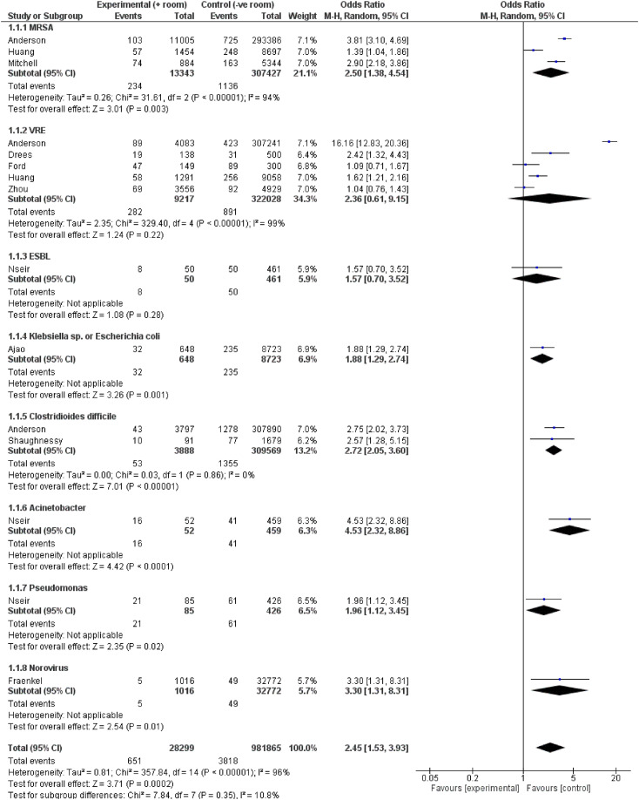
The MDRO status of the prior room occupant influences acquisition risk
Meta-analysis of studies evaluating the risk of MDRO acquisition for the incoming occupant based on the status of the prior room occupant.
 | OR | 95% CI
Acinetobacter | 4.5 | 2.3-8.9
Norovirus | 3.3 | 1.3-8.3
C. difficile | 2.7 | 2.0-3.6
MRSA | 2.5 | 1.4-4.5
VRE | 2.4 | 0.6-9.1
Pseudomonas | 2.0 | 1.1-3.4
Klebsiella or E. coli | 1.9 | 1.3-2.7
ESBL | 1.6 | 0.7-3.5
Total | 2.5 | 1.5-3.9
Mitchell et al. Infect Dis Health 2023.

Slide 15
Hydrogen peroxide vapour: clinical impact
30-month prospective cohort intervention study performed on 6 high-risk units (5 ICUs) including 8813 patients at Johns Hopkins Hospital.
64% reduction in the rate of MDRO acquisition
Standard cleaning / disinfection
HPV decontamination
Passaretti et al. Clin Infect Dis 2013;56:27-35.

Slide 16
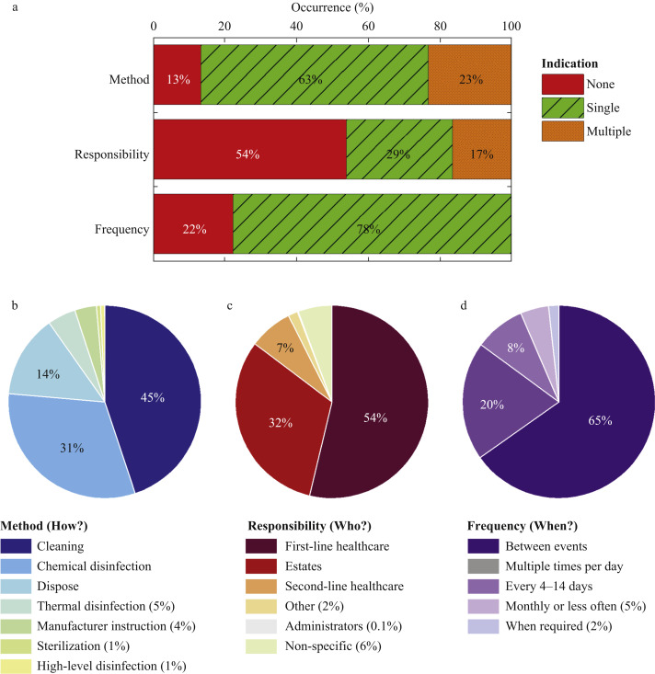
Protocols for cleaning / disinfection shared medical equipment
What do we call these things? “SNCOs” (shared non-critical objects)
BP cuffs
Clipboards
etc.
Analysis of decontamination protocols for SNCOs from 35 acute care hospitals.
Castelli et al. J Hosp Infect 2022

Slide 17
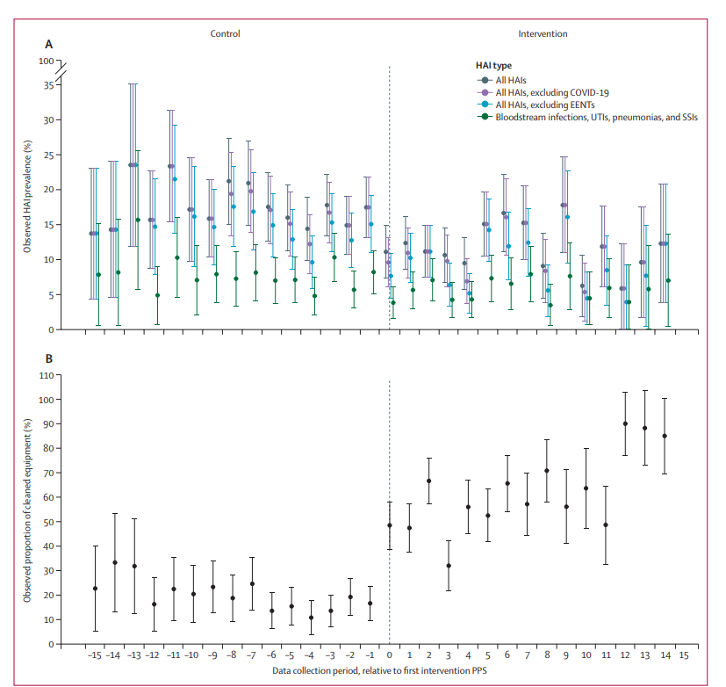
Shared medical equipment (CLEEN study)
Design: Stepped-wedge cluster RCT in 10 hospital wards (5,002 patients).
Intervention: Dedicated equipment cleaning (3 hrs per day), training, audit and feedback.
Key findings:
  35% relative reduction in HCAIs (14.9% to 9.8%; OR 0.62).
  Cleaning compliance increased from 24% to 66%.
Limitations: Single-site study with relatively high baseline HAI rates; transmission pathways not confirmed by genomic analysis.
Browne et al. Lancet Infect Dis 2024.

Slide 18
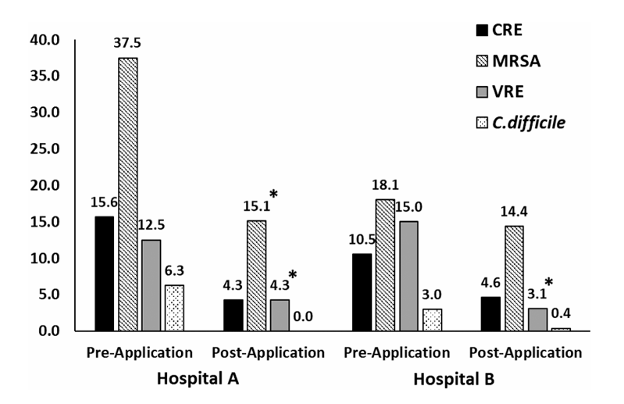
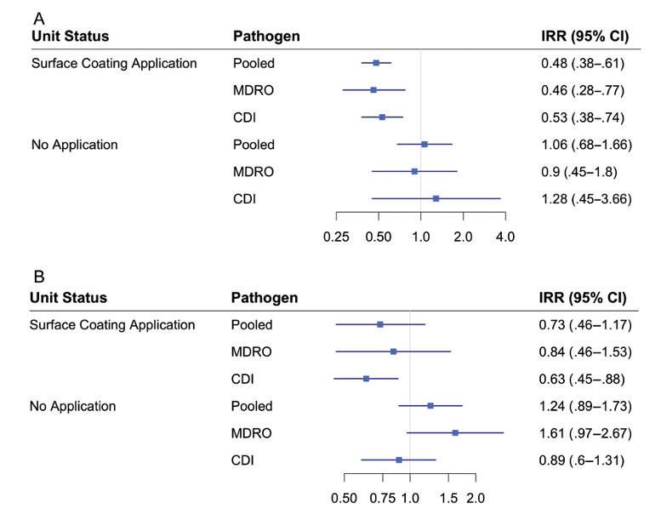
Impact of antimicrobial surfaces
Design: Controlled before-and-after study in two US hospitals
Intervention: Persistent antimicrobial coating applied across six clinical units
Results: 75–79% reduction in bacterial burden and fewer pathogen-positive surfaces
Clinical impact: 36% reduction in pooled MDRO bloodstream infections and C. difficile infections
Limitations: Non-randomised design, variable results between hospitals and no environmental sampling in control units
Ellingson et al. Clin Infect Dis 2020.

Slide 19
Hospital cleaning and disinfection works
Key studies illustrating the impact of improved cleaning and disinfection
Author/year | Design | Result
Dancer et al. 2009 | Cross-over study of extra ward cleaner | 27% reduction in MRSA infection
Datta et al. 2011 | Cohort intervention study of enhanced disinfection | Significant reduction in VRE acquisition from the prior room occupant
Anderson et al. 2017 | Cluster RCT of UVC room disinfection | Significant reduction in MDRO acquisition from the prior room occupant
Mitchell et al. 2019 | Cluster RCT of cleaning bundle | Improved rate of cleaning high touch items and reduced incidence of VRE
Dadon et al. 2023 | Cross-over study of switching from chlorine “bucket” method to disinfectant wipes | Significant reduction in surface contamination, MDRO acquisition, and in-hospital mortality

Slide 20
Importance of surface contamination for HCAI and AMR
Current approaches to cleaning and disinfection
Contaminated sinks and drains

Slide 21
Detergent
Disinfectant
PRODUCT
“Bucket method”
Wipes
Automated
PROCEDURE

Slide 22
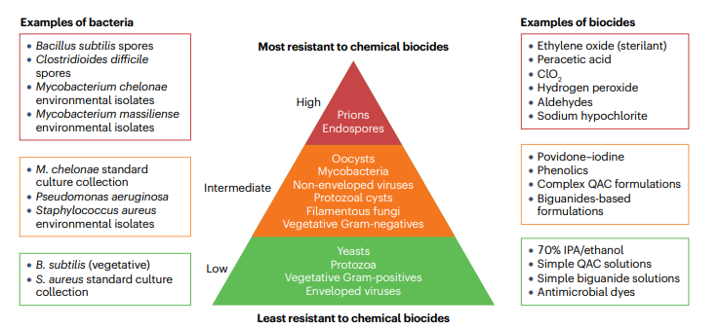
Maillard & Pascoe. Nature Rev Microbiol 2024.

Slide 23
Characteristics of an ideal surface disinfectant
Broad spectrum of activity
Contact time (realistic and uniform)
Ability to create cleaner / disinfectant
Application and availability
Material compatibility
User and surface safety
Environmental profile

Slide 24
Disinfectant chemistries (sporicidal)
Chemistry | Pros | Cons
NaDCC / sodium hypochlorite | Familiar, inexpensive and well established; broad-spectrum activity; stable tablets | Corrosive, odorous and affected by organic matter; dilution, residues, exposure and environmental concerns
Chlorine dioxide | Broad spectrum; good biofilm penetration; less affected by organic matter | Less familiar and more expensive; requires generation, storage and handling; inhalation and compatibility
Hypochlorous acid (HOCl) | Rapid broad-spectrum activity; excellent surface compatibility; low odour and irritation | Formulation stability and shelf-life challenges; performance depends on pH and manufacture; less healthcare field evidence
Peracetic acid (PAA) | Rapid broad-spectrum and sporicidal activity; effective against biofilms and in organic matter; benign breakdown products | Odour and irritation risks; activation and preparation challenges; potential material compatibility and cost issues

Slide 25
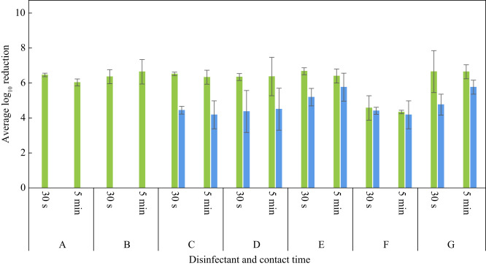
Chlorine dioxide: evidence
  Various formulations of chlorine dioxide tested
  EN testing for a range of pathogens including vegetative bacteria (including MDROs) and C. auris
  Tested P. aeruginosa (green bars) and S. aureus (blue bars) against biofilm
  Efficacy from 30 seconds against biofilms
Norville et al. J Hosp Infect 2023.

Slide 26
Chlorine dioxide: evidence
EN standard | Test/application | Organisms tested | Contact time | Log reduction
EN 13727 | Quantitative suspension test | MRSA, VRE, CRE, ESBL-producing K. pneumoniae, MDR A. baumannii | 30 sec to 5 min | >5 to >6 log₁₀ reduction
EN 14561 | Carrier test for instruments | VRE, MDR A. baumannii | 30 sec to 5 min | >5 to >6 log₁₀ reduction
EN 16615 | Four-field surface/wipe test | MRSA, VRE, CRE, ESBL-producing K. pneumoniae, MDR A. baumannii, Candidozyma auris | 30 sec to 5 min | >4 to >5 log₁₀ reduction; spread <50 CFU
EN 14562 | Carrier test for fungi/yeasts | Candidozyma auris | 30 sec to 5 min | >4 to >5 log₁₀ reduction
Norville et al. J Hosp Infect 2023.

Slide 27
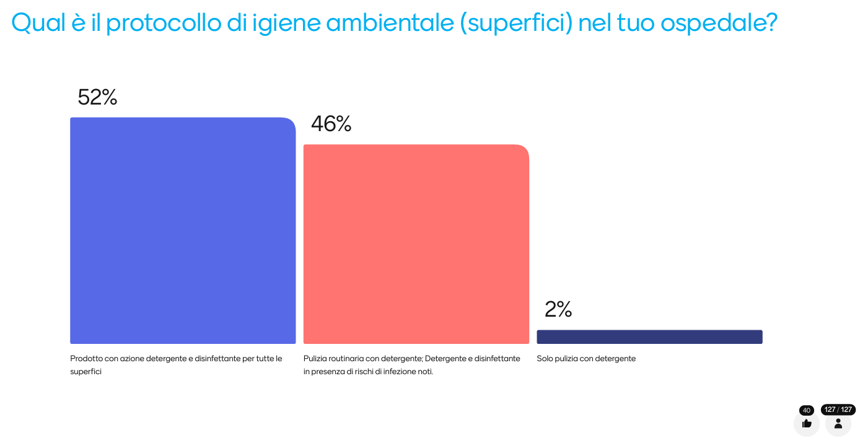

Slide 28
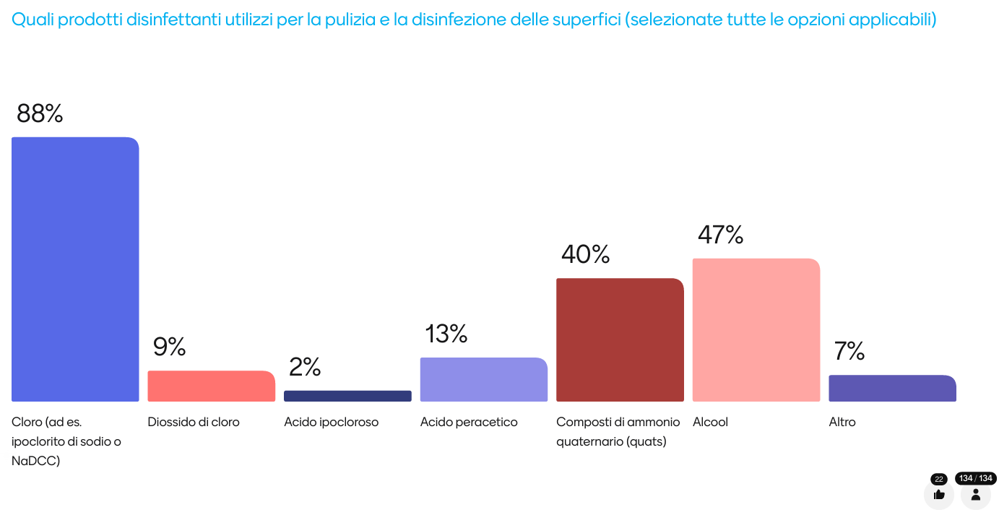

Slide 29
English cleaning / disinfection recommendations
Under Standard Infection Control Precautions, routine disinfection of the environment is not routinely recommended in the manual, aside from routine disinfection of sanitary fittings using chlorine.
Under Transmission Based Precautions, disinfection of hospital surfaces during the stay of the patient and at the time of their transfer or discharge is recommended.
The manual makes a specific recommendation that chlorine should be used for daily and discharge surface disinfection.
National Infection Control Policy Manual

Slide 30
Limitations of a “detergent only” approach
Patients with unidentified infection risks
Challenges of cleaning complex and intricate environment
Dry surface biofilms
Limited reduction in pre-post studies
Evidence that they spread contamination around
Emerging evidence of detergent-related surface damage
Evidence that moving to routine disinfection reduces transmission risk
Kiernan et al. J Hosp Infect 2024

Slide 31
Limitations of NaDCC / sodium hypochlorite
Many are not sporicidal when tested correctly
Inactivation when exposed to soiling
Poor environmental profile
Material compatibility
Staff exposure
Majority of patients on TBPs don’t require chlorine
Kiernan et al. J Hosp Infect 2024

Slide 32
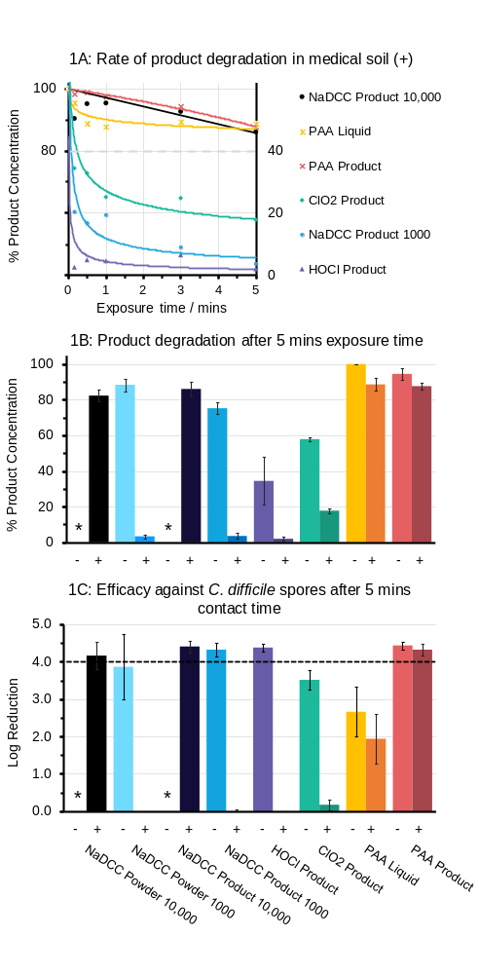
Impact of soiling
Assessed sporicidal efficacy against Clostridioides difficile using EN 17126.
Chlorine-based products lost efficacy in dirty conditions.
Peracetic acid remained effective in both clean and dirty conditions.
Product formulation significantly influenced performance.
Highlights the importance of testing under realistic soiling conditions.
Brown et al. J Hosp Infect 2024
* = not tested

Slide 33
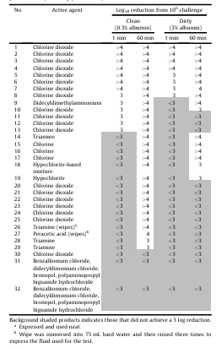
Is it sporicidal?
Tested 32 disinfectants against Clostridioides difficile spores under clean and dirty conditions.
16 products passed after 60 minutes, but only eight passed within a clinically realistic one-minute contact time.
Organic soil substantially reduced the activity of many products.
A “sporicidal” claim did not guarantee rapid efficacy under realistic conditions.
Product selection should consider contact time, soiling and intended use, not simply the label claim.
Speight et al. J Hosp Infect 2011.

Slide 34
Importance of surface contamination for HCAI and AMR
Current approaches to cleaning and disinfection
Contaminated sinks and drains

Slide 35
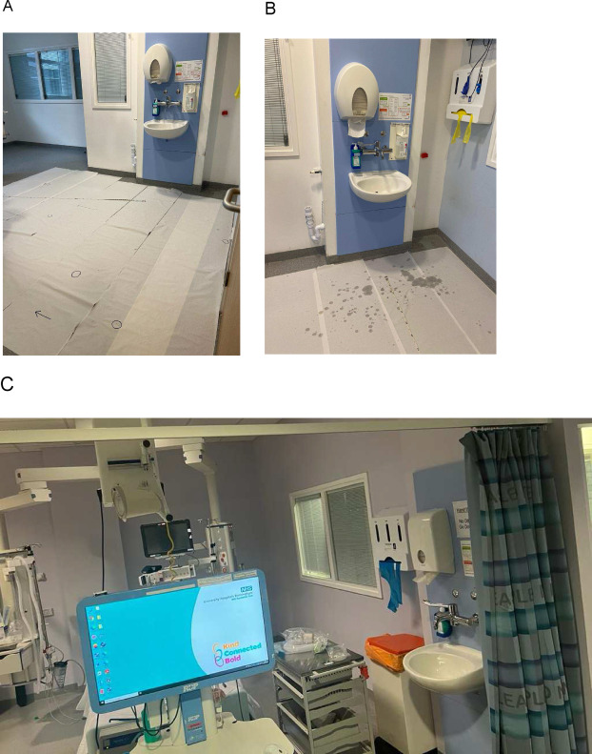
The sink splash zone
Category | Examples | Prevalence
A | Vascular access equipment | 65%
Bi | Ventilator equipment | 18%
Bii | Respiratory equipment | 27%
C | Hemofiltration / dialysis | 12%
D | Personal care items | 68%
E | Nutrition / enteral care | 33%
F | Alcohol gel / PPE | 57%
G | Housekeeping / cleaning | 5%
H | Patient skin contact items | 43%
I | Medicines / infusion pumps | 32%
J | Negative pressure wound care | 5%
K | Patients with IV devices | 12%
L | Patients with urinary catheters | 18%
M | Invasive monitoring equipment | 5%
N | Patients admission packs | 5%
O | Computers on wheels | 48%
The sink splash zone. Panel A: after running the tap. Panel B: after hand hygiene. Panel C: equipment in the sink splash zone.
Garvey et al. Infect Prevent Practice 2023.

Slide 36
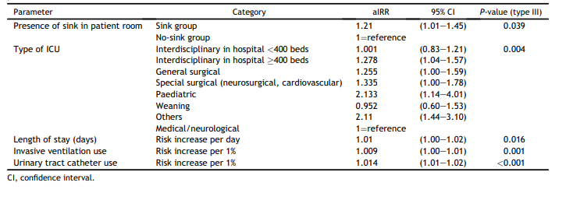
Proximity to sinks associated with more HCAI
Retrospective cohort study including 552 German ICUs, comparing HCAI prevalence in patients cared for in rooms with or without sinks.
Multivariable analyses identified sinks as a risk factor for BSIs and UTIs
Fucini et al. J Hosp Infect 2023.

Slide 37
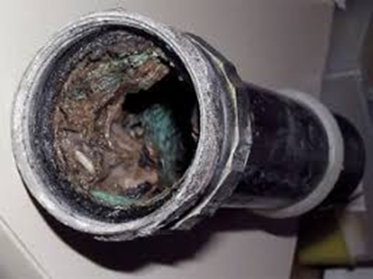
Options for disinfecting drains
  Thermal (hot water/steam)
  Chemical
  Physical (removal)
  Emerging technologies
Warren & Anderson. Am J Infect Control 2026.

Slide 38
The role of cleaning and disinfection in preventing HCAI
Jon Otter PhD FRCPath FIBMS
Director of Infection Prevention and Control & Consultant Clinical Scientist
Guy’s and St Thomas’ NHS Foundation Trust
Honorary Senior Lecture in HCAI & AMR, Imperial College London
Co-founder IPC Partners
@jonotter
jon.otter@nhs.net

Slide 39




An introduction to Journal Clubs /
Insight Webinars
Aims
To provide an expert overview of a relevant topic
(Insight Webinars) or paper (Journal Club)
To generate discussion
To provide opportunities for CPD
To exercise critical thinking skills
To build confidence for independent research & study
To foster a network of enthusiasts
To have a bit of fun!
https://ipcpartners.org/learn-with-us/
Insight Webinars and Journal Clubs are recorded and made available online after the event.

