Slide 1




Top 5 Trends in SSI Prevention
Jon Otter PhD FRCPath FIBMS
Director of Infection Prevention and Control & Consultant Clinical Scientist
Guy’s and St Thomas’ NHS Foundation Trust
Honorary Senior Lecture in HCAI & AMR, Imperial College London
@jonotter
jon.otter@nhs.net

Slide 2
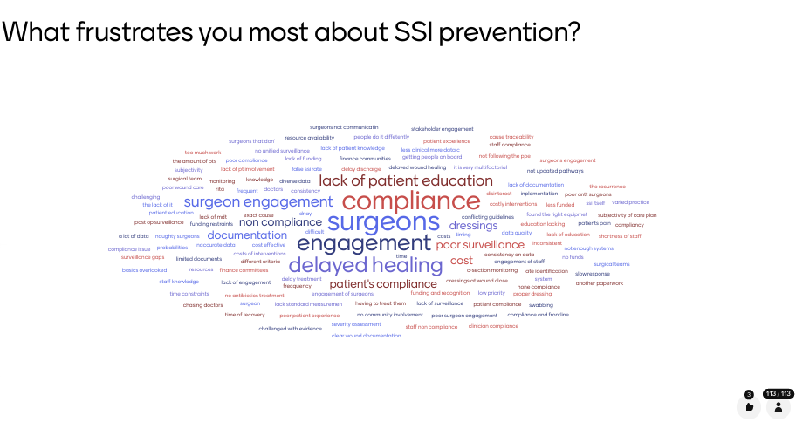

Slide 3
2036

Slide 4
Cost and value
Focus on homeostasis
Patient participation – wider health
Precision prevention
Innovation

Slide 5
Cost and value
Focus on homeostasis
Patient participation – wider health
Precision prevention
Innovation

Slide 6
Infections related to surgery vs. SSI
SSI
Respiratory infections (HAP, VAP)
Urinary tract infections
Invasive infections
DRIs

Slide 7
SSI
Patient experience
££
Reputation/ patient choice
Antimicrobial resistance

Slide 8
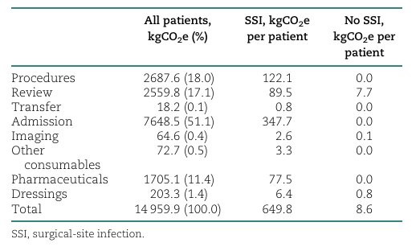
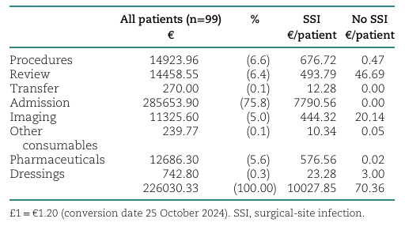
Carbon cost
Design: Prospective observational study of 99 patients following lower-limb vascular surgery in one UK centre.
SSI incidence: 22 patients (22%) developed a surgical-site infection.
Environmental impact: Mean emissions were over 60-fold higher with SSI than without SSI: 644 versus 10 kgCO₂e per patient.
Financial impact: Mean cost was approximately €10,018 with SSI, compared with €73 without SSI.
Severity matters: Environmental and financial costs increased markedly with infection severity; moderate and severe SSI accounted for 88% of emissions and 95% of financial costs.
Main cost driver: Readmission generated 51% of emissions and 76% of financial costs.
Lathan et al. BMJ Open 2025.

Slide 9
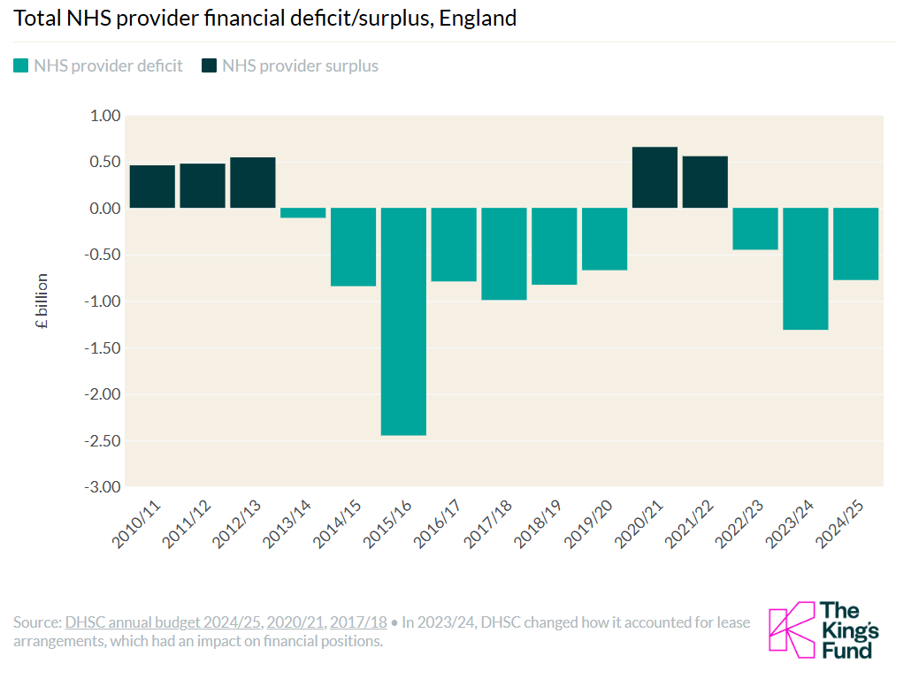

Slide 10
Cost and value
Focus on homeostasis
Patient participation – wider health
Precision prevention
Innovation

Slide 11
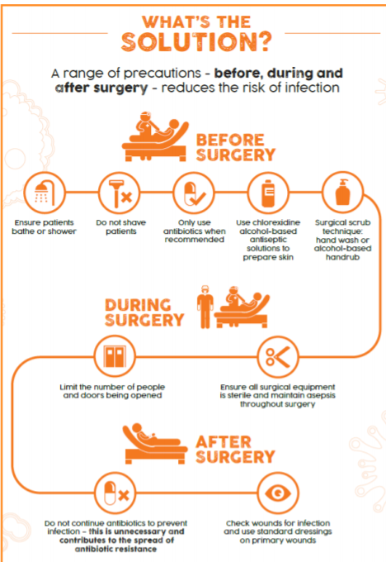
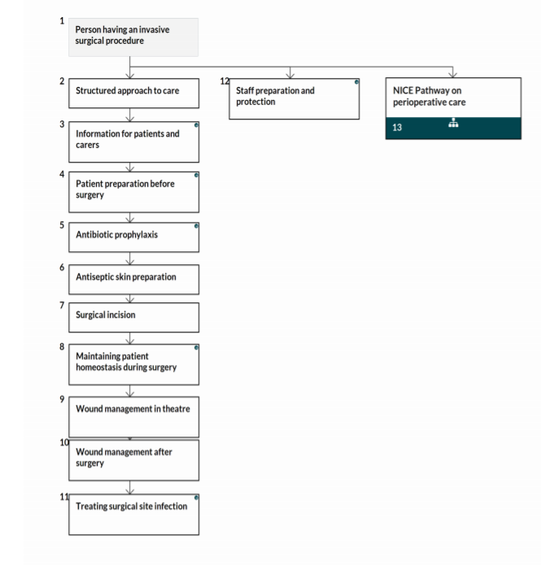
What happened to normothermia?
NICE pathways
https://www.theific.org/wp-content/uploads/2017/10/36.pdf

Slide 12
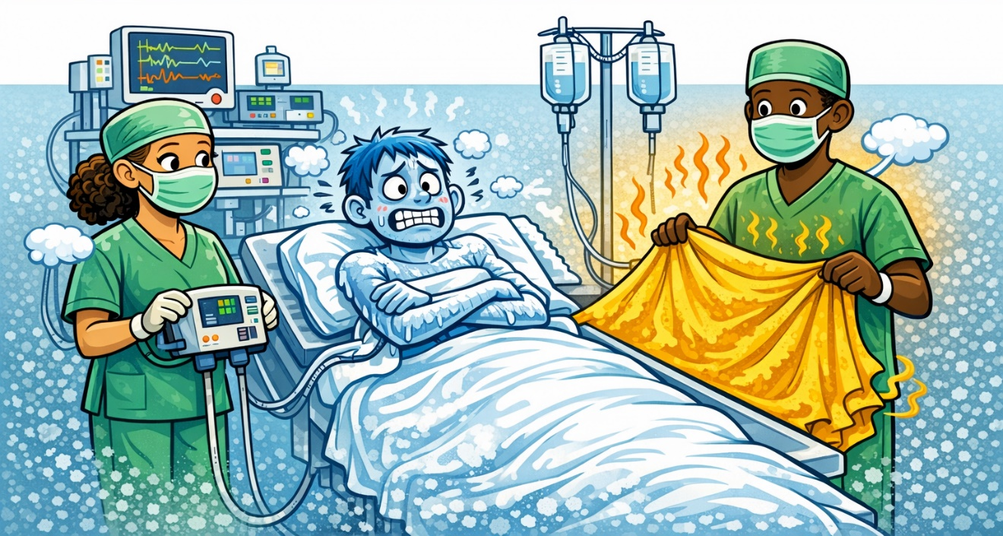

Slide 13
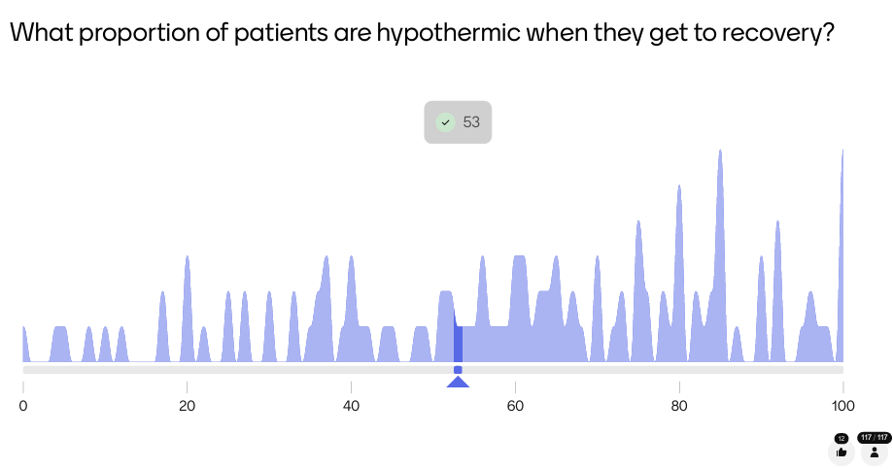

Slide 14
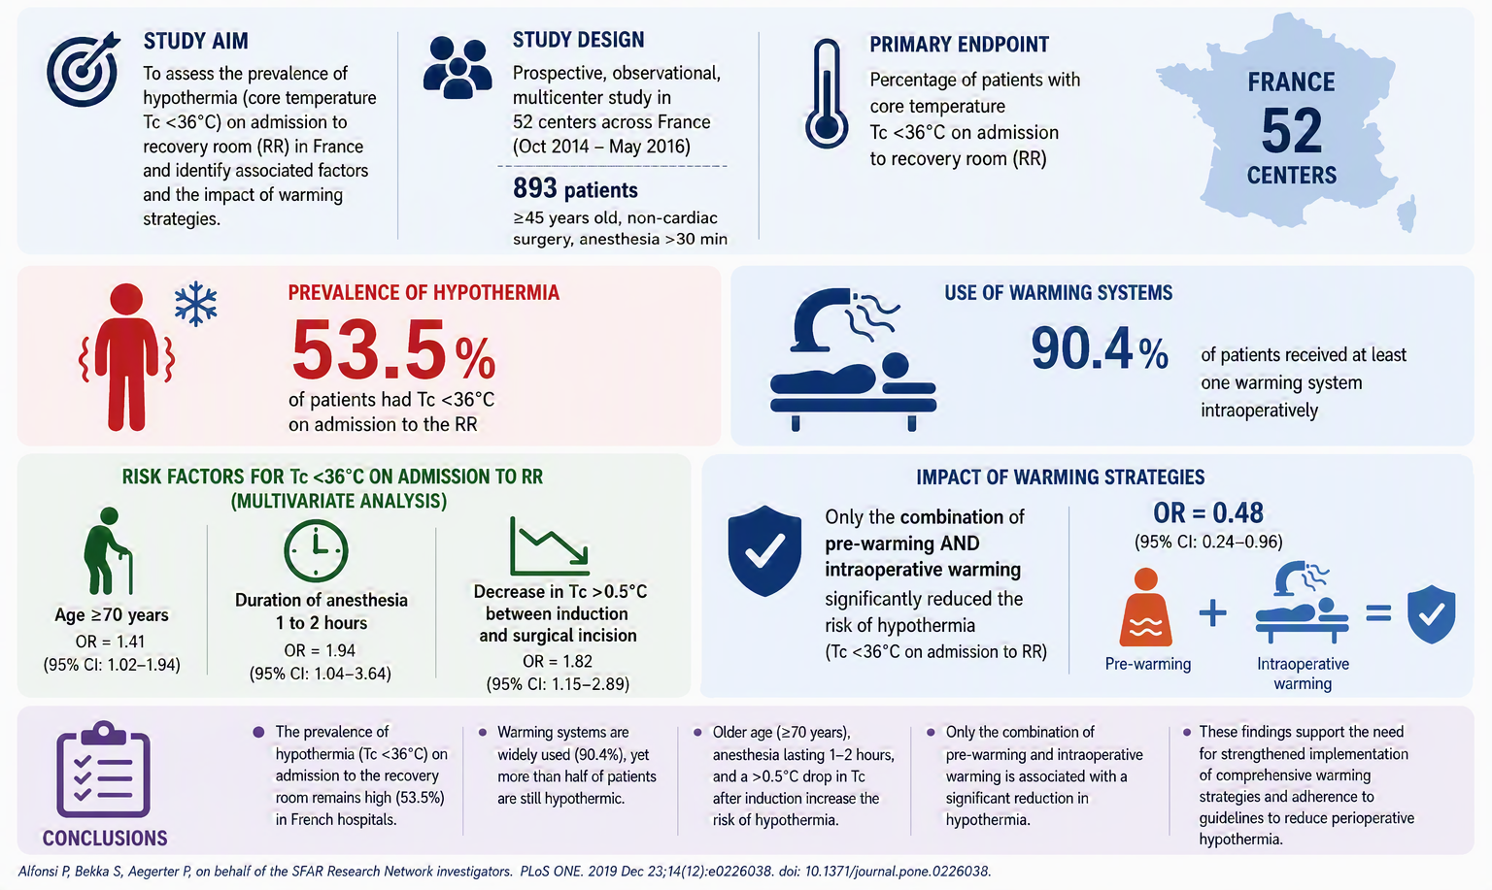

Slide 15
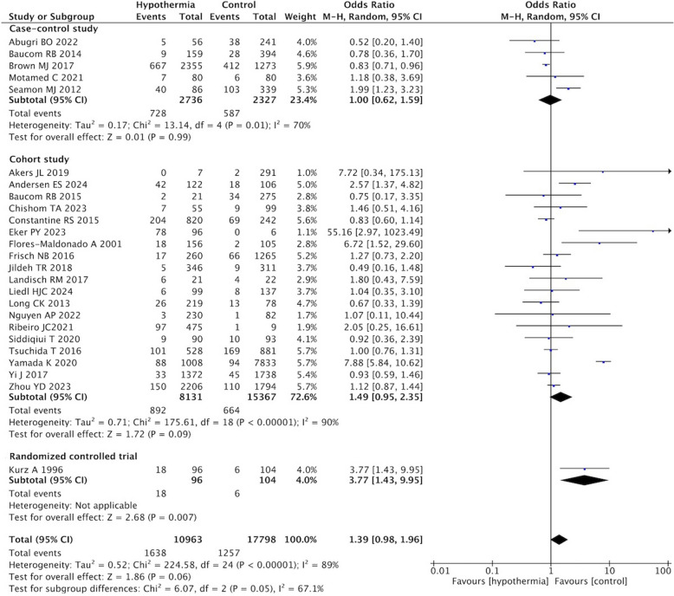
Hypothermia – impact – SSI
Systematic review and meta-analysis of 25 studies.
Chen et al. BMC Anaesthesiol 2025.

Slide 16
Impact of hypothermia in surgery
Increased surgical-site infection risk through impaired tissue oxygenation and immune function, approximately 2x risk.
Increased bleeding and transfusion requirements due to impaired coagulation (average +500 mL).
Higher risk of adverse cardiac events in susceptible patients (+55% risk).
Wound healing impact.
Shivering, discomfort and delayed recovery, potentially prolonging recovery and hospital stay.
Kurz et al., NEJM 1996; Schmied et al., Lancet 1996; Frank et al., JAMA 1997; Pietsch et al., Anaesthesist. 2007; NICE CG65.

Slide 17
More than normothermia
Guideline | Glycaemic Control | Normothermia | Oxygenation | Fluid Management
ACS/SIS (2017) | ✓ | ✓ | ✓ | ✗
CDC (2017) | ✓ | ✓ | ✓ | ✗
ACOG (2018) | ✓ | ✗ | ✗ | ✗
WHO (2018) | ✓ | ✓ | ✓ | ✓
APSIC (2019) | ✗ | ✓ | ✗ | ✓
NICE (2019) | ✓ | ✓ | ✓ | ✓
Spanish Assn. of Surgery (2020) | ✓ | ✓ | ✓ | ✓
SHEA/IDSA/APIC (2023) | ✓ | ✓ | ✓ | ✗
Le Couteur et al. Anaesthesiology 2025.

Slide 18
Cost and value
Focus on homeostasis
Patient participation – wider health
Precision prevention
Innovation

Slide 19
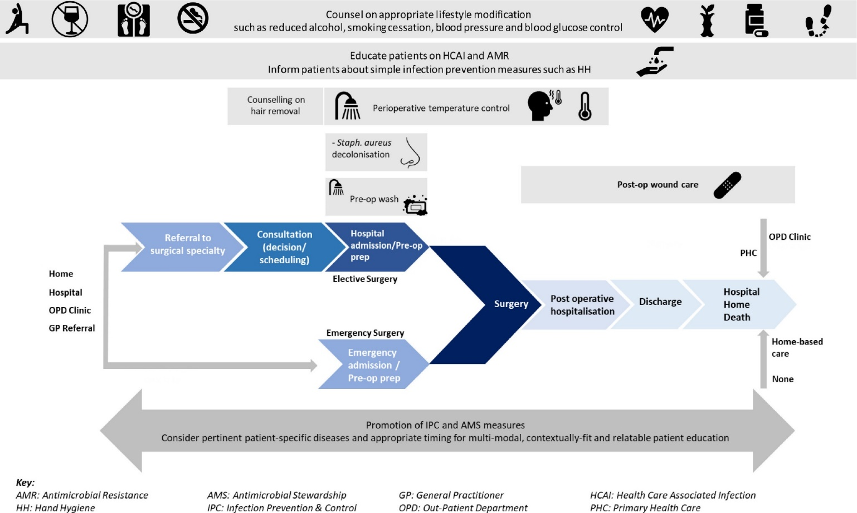
Patient participation in SSI prevention
Scoping review of patient understanding of and participation in infection-related care across surgical pathways
Mbamalu et al. Int J Infect Dis 2021;110:P123-134.

Slide 20
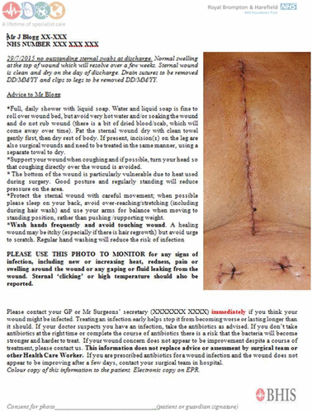
‘Photo at discharge’
568 patients who received a ‘Photo at Discharge’ were matched with 568 patients who did not.
The rate of admission for SSI was significantly lower for the PaD group vs. the non-PaD group (2/568 vs. 10/568, p=0.01).
Rochon et al. J Infect Prevet 2018.

Slide 21
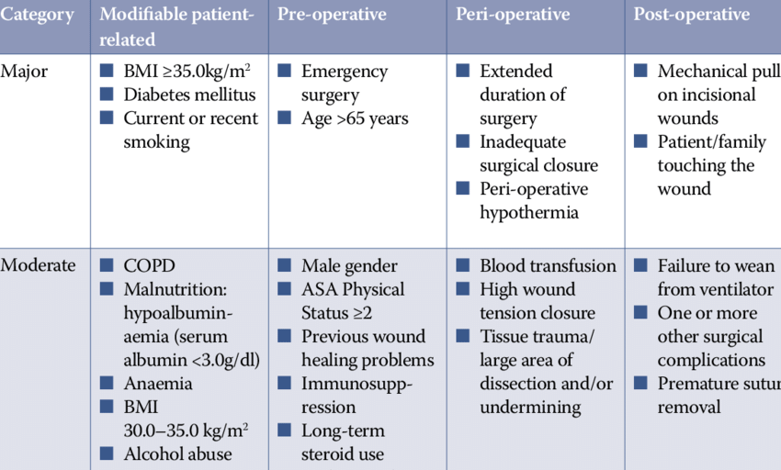
Risk factors for SSI
Younis et al. Wounds UK 2020.

Slide 22
Where is pre-op optimsation?
NICE pathways
https://www.theific.org/wp-content/uploads/2017/10/36.pdf

Slide 23
Pre-op optimisation: smoking
Smoking cessation before surgery is cost-effective and often cost-saving.
Programmes combining counselling + pharmacotherapy provide the greatest benefit.
Reduces postoperative complications, including SSIs and wound problems.
Associated with shorter hospital stays and fewer readmissions.
Supports routine integration of smoking cessation into preoperative pathways.
McCaffrey et al. Int J Surg 2023.

Slide 24
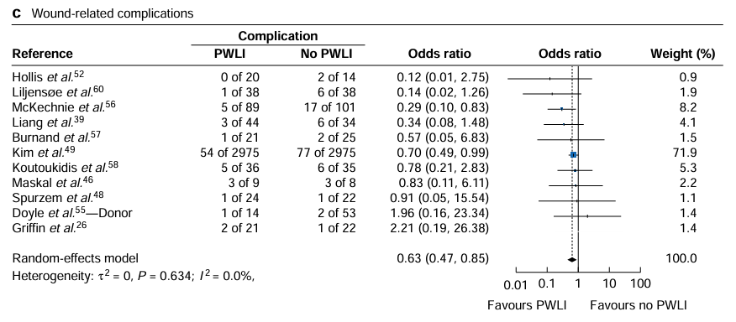
Pre-op optimisation: weight loss
Systematic review and meta-analysis of weight loss prior to bariatric surgery.
35 studies; 9,378 patients
Pre-op weight loss reduced overall complications by 37%
Reduced wound complications, readmissions, and length of stay
Achieved ~4 kg greater weight loss, mainly from fat mass
No significant reduction in SSI rates
Wang et al. BJS Open 2026.

Slide 25
Cost and value
Focus on homeostasis
Patient participation – wider health
Precision prevention
Innovation

Slide 26
Precision prevention
Current SSI prevention relies on broad measures, but infections continue to occur.
Rapid diagnostics could enable real-time identification of pathogens and antimicrobial resistance before surgery.
Predictive analytics using patient-level data may identify patients at highest risk of SSI and guide targeted interventions.
Precision antimicrobial prophylaxis could tailor agent selection and dosing to the individual patient and microbiome.
Price JR. Annals Royal College Surgeons England, 2022.

Slide 27
Screen + suppression = precision prevention
Screen for S. aureus (MSSA/MRSA) before cardiac and orthopaedic surgery.
Decolonise carriers with intranasal mupirocin ± chlorhexidine.
Add vancomycin prophylaxis for MRSA carriers undergoing cardiac, orthopaedic, or neurosurgery.
Use a combined bundle (screening, decolonisation, targeted prophylaxis) for MRSA carriers in high-risk surgery.
Insufficient evidence to recommend screening or treatment strategies for VRE or other MDR Gram-positive organisms.
Righi et al. Clin Microbiol Infect 2024.

Slide 28
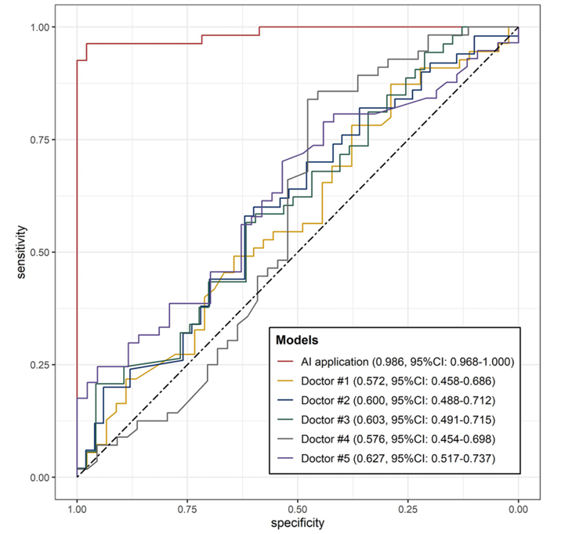
Individualised dynamic SSI risk
667 patients used to develop and validate an AI SSI prediction model.
GBM model showed excellent accuracy (AUC 0.99; external validation AUC 0.85).
Main risk factors: surgery duration, tumour type, and comorbidities.
AI predictions were more accurate than clinician assessment.
Supports personalised SSI risk stratification and prevention.
Cui et al. Int J Surg 2025.

Slide 29
Cost and value
Focus on homeostasis
Patient participation – wider health
Precision prevention
Innovation

Slide 30
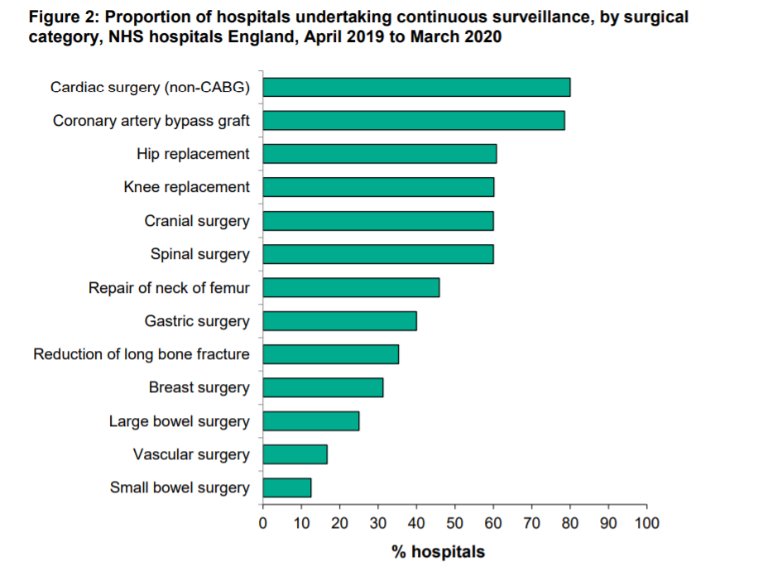
Half the story…
PHE SSI Surveillance Annual Report, 2019/20.

Slide 31
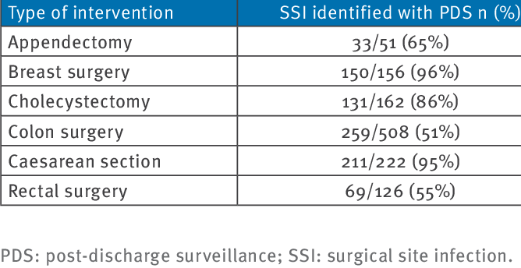
Less than half the story: post-discharge surveillance
Italian national SSI programme, 2019-2012.
Marchi et al. Eurosurveill 2014

Slide 32
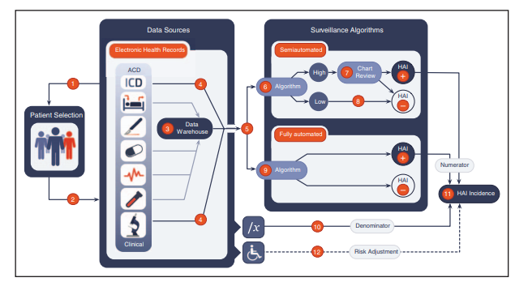
Sips et al. Curr Opin Infect Dis 2017;30:425-431.

Slide 33
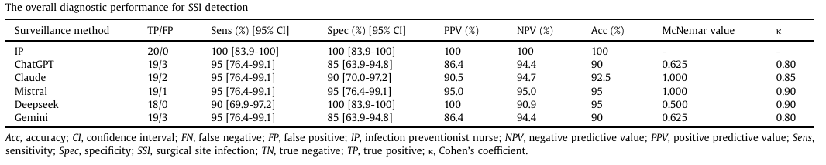
AI for surveillance
Study design: Retrospective single-centre pilot study comparing five LLMs with manual NHSN-based SSI surveillance in 40 abdominal surgery patients (20 SSI, 20 non-SSI).
Key findings: All LLMs achieved high diagnostic accuracy (90-95%) with strong agreement to manual review (κ 0.80-0.90) and no significant difference from the infection preventionist.
Limitations: Small sample size, single-centre retrospective design, and findings may be influenced by documentation quality and use of a single standardised prompt.
Abbas et al. Am J Infect Control 2026.

Slide 34
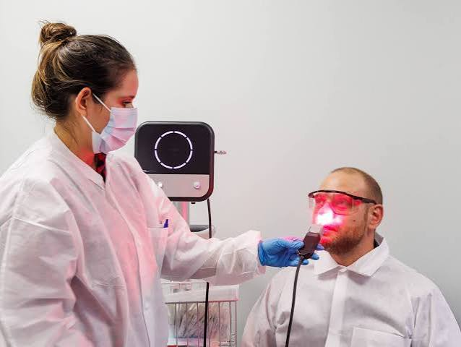
Nasal photodisinfection
200 patients undergoing endoscopic anterior skull base surgery
Nasal photodisinfection reduced SSI from 14.6% to 3.2% (absolute reduction 11.4%)
No cases of post-operative meningitis after photodisinfection (vs 5 with standard care)
100% compliance and no adverse events
Suggests a rapid, non-antibiotic alternative to conventional nasal decolonisation
Nix et al. J Laryngology & Otology, 2026.

Slide 35
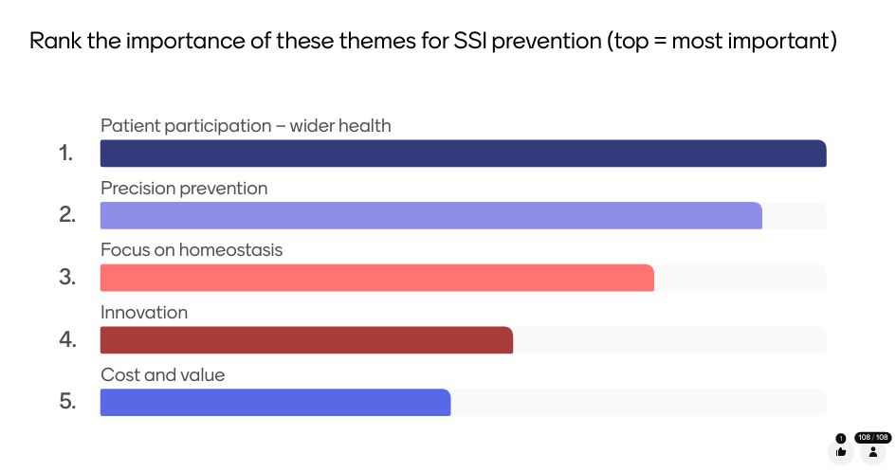

Slide 36
Top 5 Trends in SSI Prevention
Jon Otter PhD FRCPath FIBMS
Director of Infection Prevention and Control & Consultant Clinical Scientist
Guy’s and St Thomas’ NHS Foundation Trust
Honorary Senior Lecture in HCAI & AMR, Imperial College London
@jonotter
jon.otter@nhs.net

